Slide 1
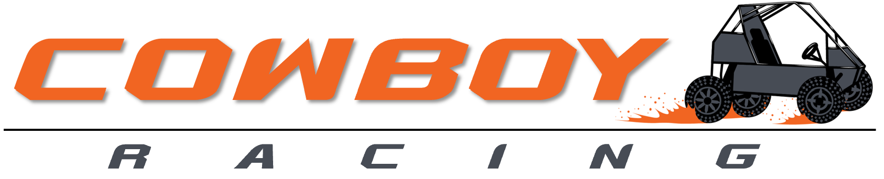
Creating Excellence in Design, Build, and Drive since 1995
Critical Design Review

Slide 2
Problem Description
Design and develop a front suspension system for the 2023-2024 Cowboy Racing Mini Baja Car that maximizes the strength to weight ratio, minimizes unsprung weight, and has suitable geometry for off road vehicles.

Slide 3
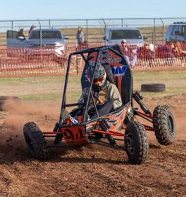
Detailed Design
Material Selection A-Arm/Knuckles
Suspension Geometry
Knuckle Design

Slide 4
Material Selection A-Arms/Knuckles
Objectives:
Choose a material with a strength to weight ratio greater than or equal to the current 4130 Chromoly steel.
Minimize unsprung weight
Constraints:
Choose materials that are reasonable in cost.
Materials shall be MIG weldable- minimize out of house production
Design Decision:
A-Arms: FinishLineST™ 4130 Steel Tubing 1x.049”
Knuckles: 6061 T6 Aluminum

Slide 5
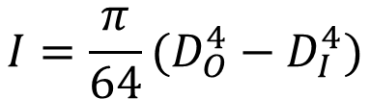
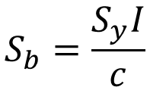

Material Selection A-Arm
FinishLineST 4130 Steel Tubing 1x.049”
$$I=\frac{π}{64}(D_{O}^{4}−D_{I}^{4})$$
$$k_{b}=EI$$
$$S_{b}=\frac{S_{y}I}{c}$$
Determined FinishLineST 4130 was the most suitable material
Eliminated 2507 Duplex from material selection
  Requires 1925°F heat treatment after cold forming
  Can not be welded in house

Slide 6
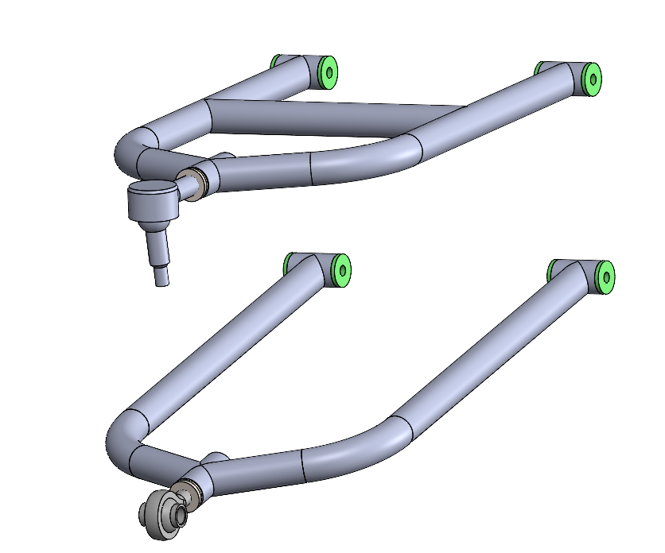
Material Selection A-Arm
Designed Cowboy Racing A-Arm Design

Slide 7
Suspension Geometry Design
2D Suspension Geometry Design
Iterated through 2D Suspension Geometry model to find different suspension geometry settings and their criteria listed below
  Distance from Roll Center to Center of Gravity
  Scrub Radius
  Ground Clearance
  Static Camber
  Static Toe
  Variable Camber
Tested 6 different A-Arm lengths and altered KPI so camber was as close to 0º as possible and scrub radius to be as small as possible
On each of the A-Arm lengths we iterated the shock location and knuckle diameter and recorded the values above

Slide 8
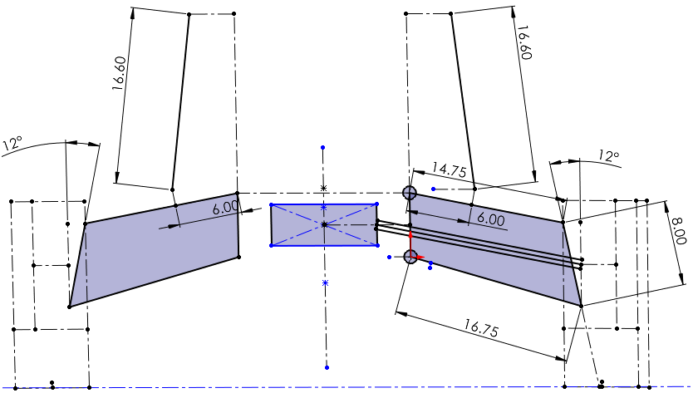
Suspension Geometry Design
2D Suspension Geometry Design
Shock length
Upper A-Arm length
Frame to shock pickup length
Lower A-Arm length
KPI angle
Upper to lower pickup length

Slide 9
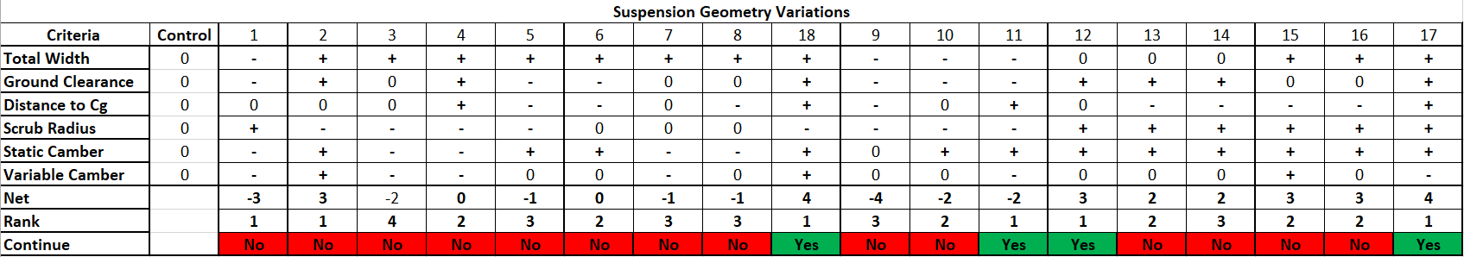
Suspension Geometry Design
2D Suspension Geometry Design Screening Matrix
Above is the Screening Matrix for the 18 suspension geometry settings that we tested
We selected the best version of each of the A-Arm lengths determined by our initial research and continued with Variations 11,12,17 and 18
Even though Variation 3 had the highest score we decided not to continue with this design as the scrub radius was well out of the desired range
  This design would cause a large amount of tension on the tie rod which is a common failure point in previous Baja car designs

Slide 10
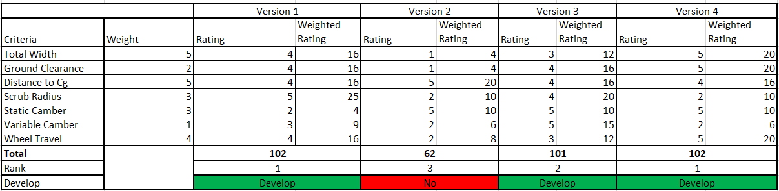
Suspension Geometry Design
2D Suspension Geometry Design Scoring Matrix
After selecting the 4 Variations, we added the criteria of wheel travel
The criteria that had the highest weightings were Total Width, Roll Center Distance to Center of Gravity, Wheel Travel, and Scrub Radius
After completing the Scoring Matrix, the Versions that we developed in Optimum Kinematics Simulation were Version 1, 3, and 4
The Version that we are initially pursuing is Version 1 as it has the best trade offs between all the Suspension Geometry settings that we researched

Slide 11
Suspension Geometry Design
Optimum Kinematic Simulations
Created 3D models based on the 2D suspension design models and data points of the Baja car
3 Front Suspension models of our selected designs were created, and a Rear Suspension model was created to run simulations on
For the simulations we decided to focus on body roll and steering at the maximum values possible by the Baja car
Ran the simulations and acquired data for each of the suspensions based on the following values
  Total Width
  Roll Center distance to the Center of Gravity in the Z-Axis
  Scrub Radius
  Variable Camber

Slide 12
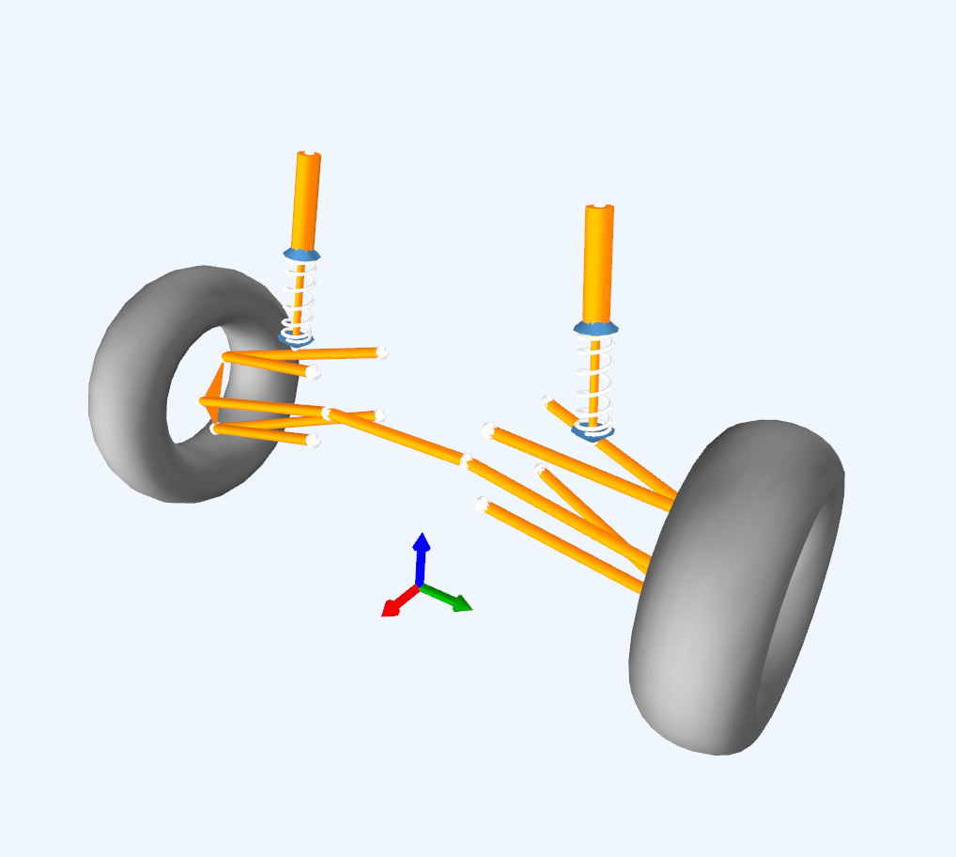
Suspension Geometry Design
Optimum Kinematic Front Suspension Models
  All points based off of the origin of the 2D and 3D model – middle of axel at ground level
  Pick Up Points of A-Arms onto Baja Car
    Added 6 degrees of incline to the front pickup points to accommodate for the caster on the frame
  A-Arm Attachment Points to Knuckle
  Tie Rod Attachment to Knuckle and Steering Rack
  Shock attached to Baja Car and Upper A-Arm
  Repeated the creation for all 3 Front Suspension Models based off 2D model points
Front Suspension Model in Optimum Kinematic

Slide 13
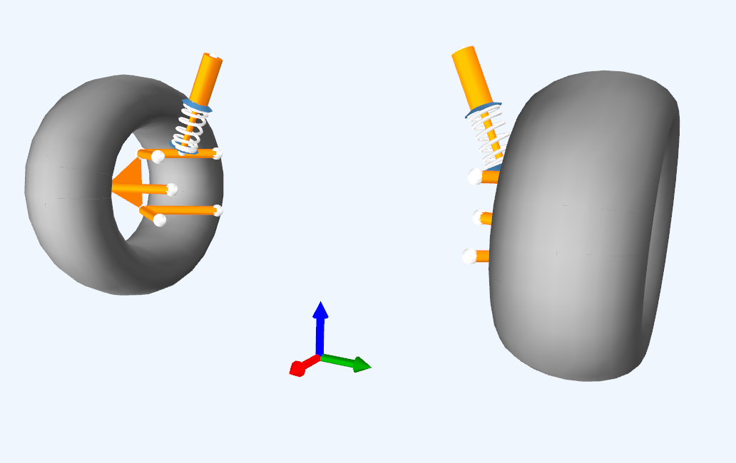
Suspension Geometry Design
Optimum Kinematic Rear Suspension Models
Based on the current Cowboy Racing Semi Trailing Arm Rear Suspension
Had to be modified to the best representation of a Double A-Arm since Optimum Kinematics cannot model a Semi Trailing Arm Suspension
All 3D points were modeled in the same way as the front suspension
Rear Suspension Model in Optimum Kinematic

Slide 14
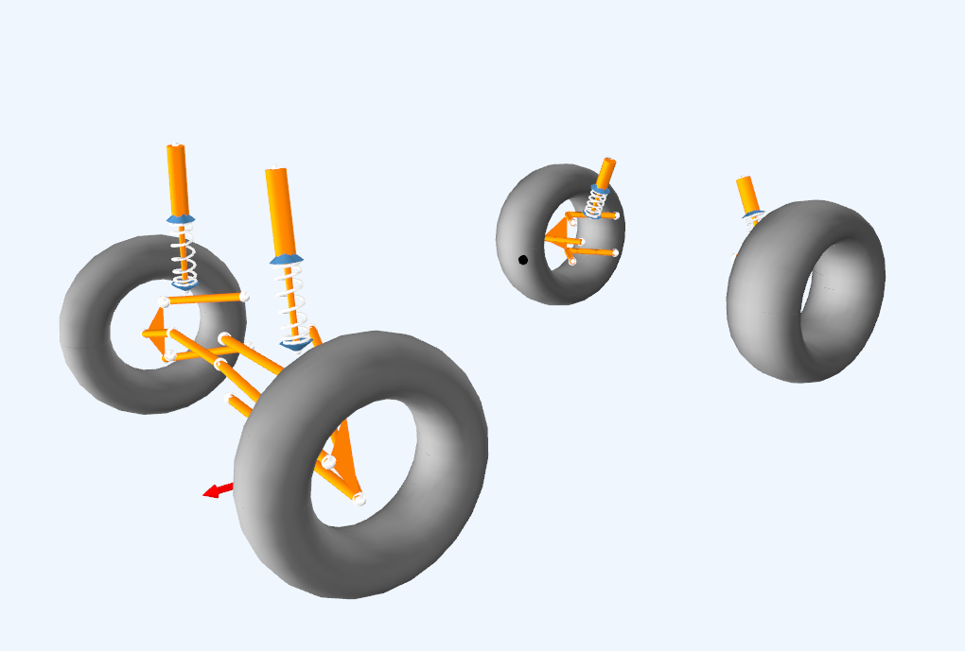
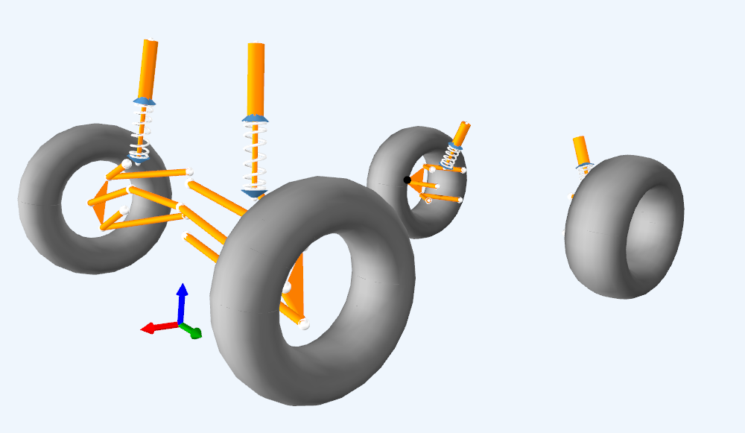
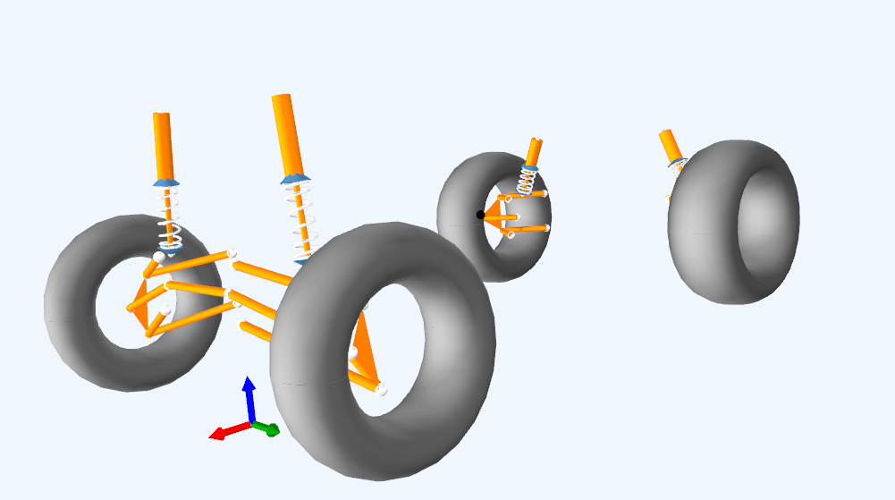
Suspension Geometry Design
Optimum Kinematic Vehicle Models
Version 2
Version 1
Version 3

Slide 15
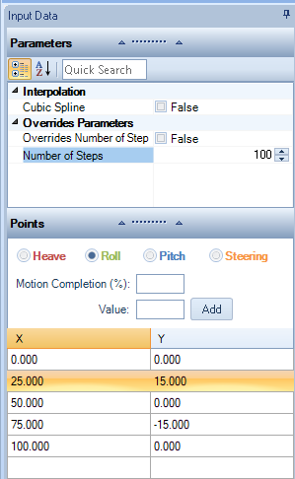
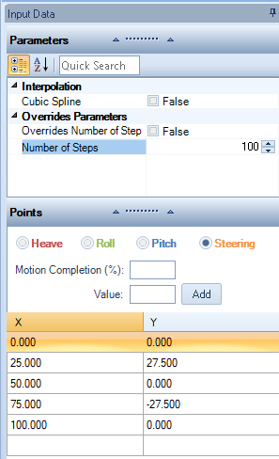
Suspension Geometry Design
Optimum Kinematic Simulation Settings
Created Simulation Data Points with 2 Parameters
Body Roll from a range of 15 degrees to -15 degrees
Steering Angle from a range of 27.5 degrees to -27.5 degrees
Maximum Body Roll and Steering Angle value calculated from a MATHCAD file of the Baja Car based on the Distance from Roll Center to Center of Gravity and multiple Baja car parameters

Slide 16
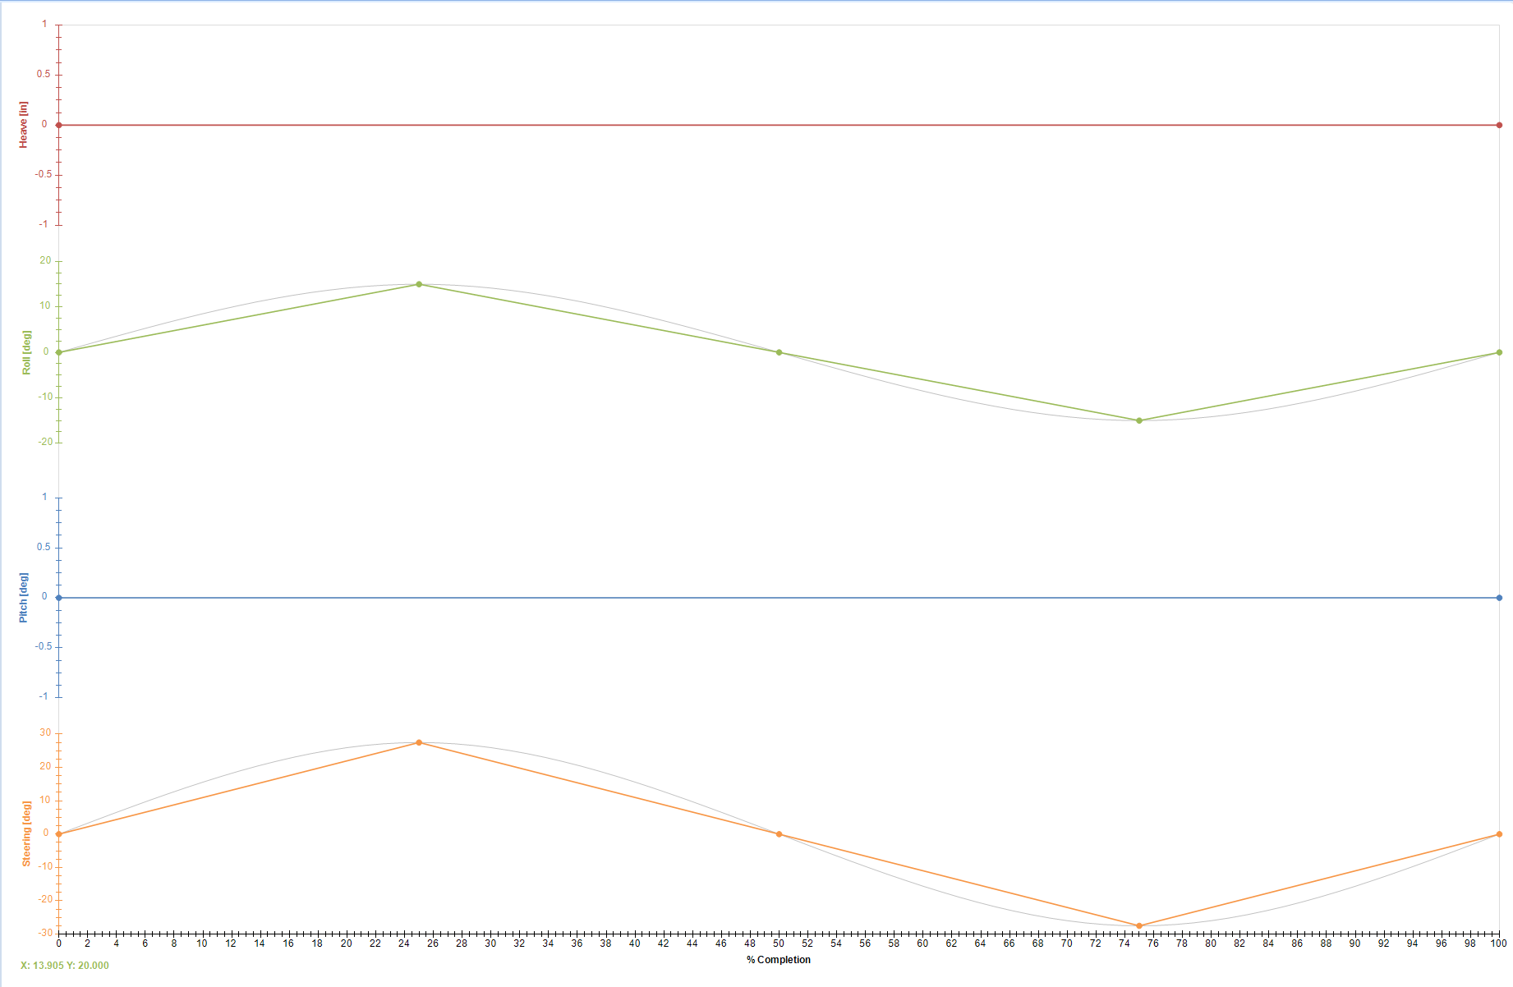
Suspension Geometry Design
Graph of Optimum Kinematic Simulation Settings

Slide 17
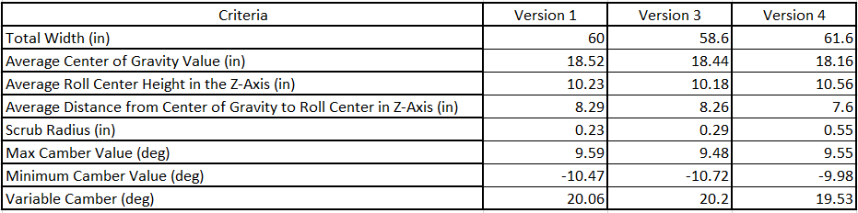
Suspension Geometry Design
Optimum Kinematic Simulation Results
Average Value of Criteria from Optimum Kinematic Simulation based on Body Roll and Steering Angle Parameters
Selected from a large list of values Total Width, Average Distance from the Center of Gravity to the Roll Center in Z-Axis, Scrub Radius, and Variable Camber to focus on as the results from the simulation

Slide 18
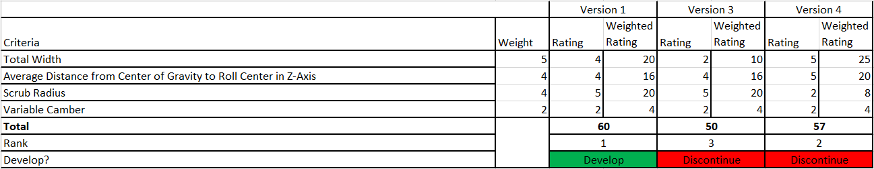
Suspension Geometry Design
Optimum Kinematic Simulation Scoring Matrix
Created a Scoring Matrix of the simulation values to determine which version we wanted to proceed with as our final design to implement on the knuckle
Selected Version 1 as it had the best overall score
Optimum Kinematic Simulation validated the 2D Suspension Design and showed how the different criteria change throughout the simulation

Slide 19
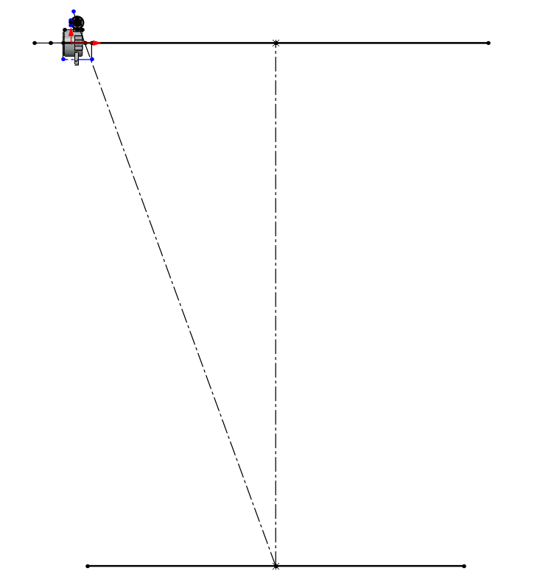
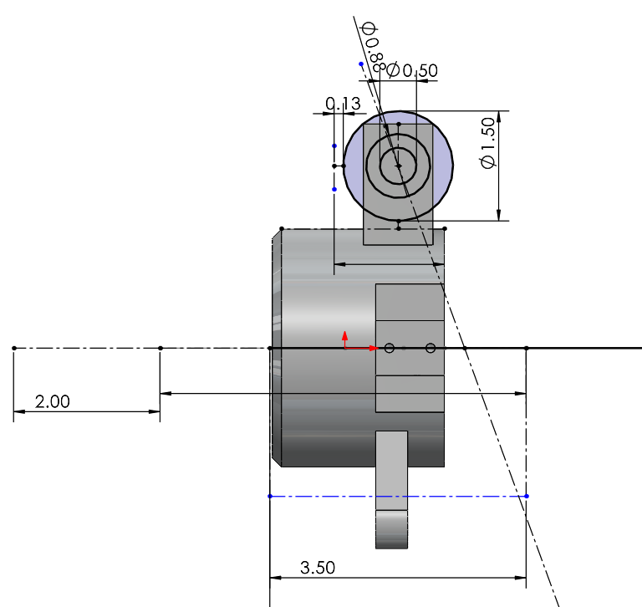
Steering Geometry Design
Ackerman Steering Design

Slide 20
Knuckle Design
Objectives:
Design a Knuckle that satisfies the connection between the Tie Rod (Steering), A-Arms, and Wheel Hub.
Designing this connection out of the strongest, but lightest material (Maximizing Strength Vs. Weight Ratio)
Constraints:
Designing something that is reasonable in cost.
Designing something that we can make in house.
Integrating with the other subsystems. (Suspension Geometry and Steering position).
Design Decision:
The knuckle is comprised of two pieces, a base and an upright
CNC knuckle base and upper upright out of aluminum
Bolt knuckle base and upper upright together

Slide 21
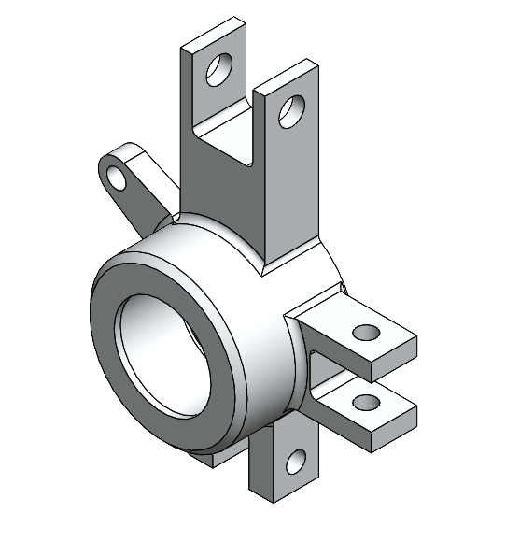
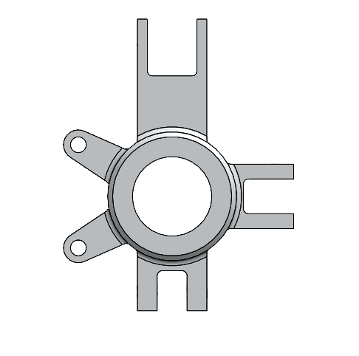
Knuckle Design
The knuckle is set by suspension geometry.

Slide 22
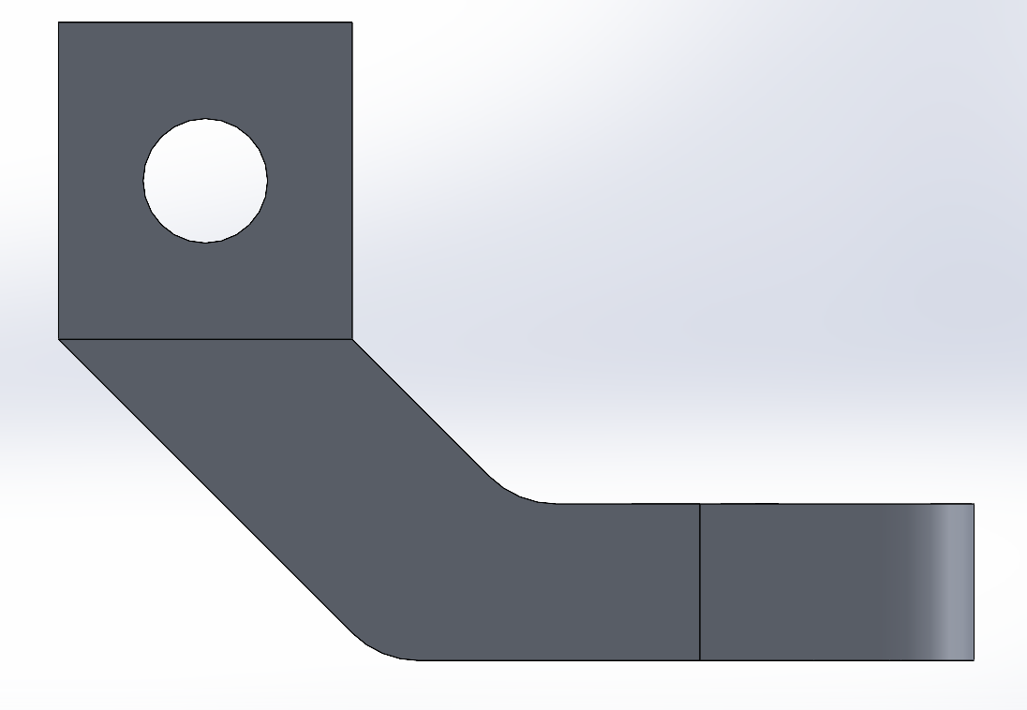
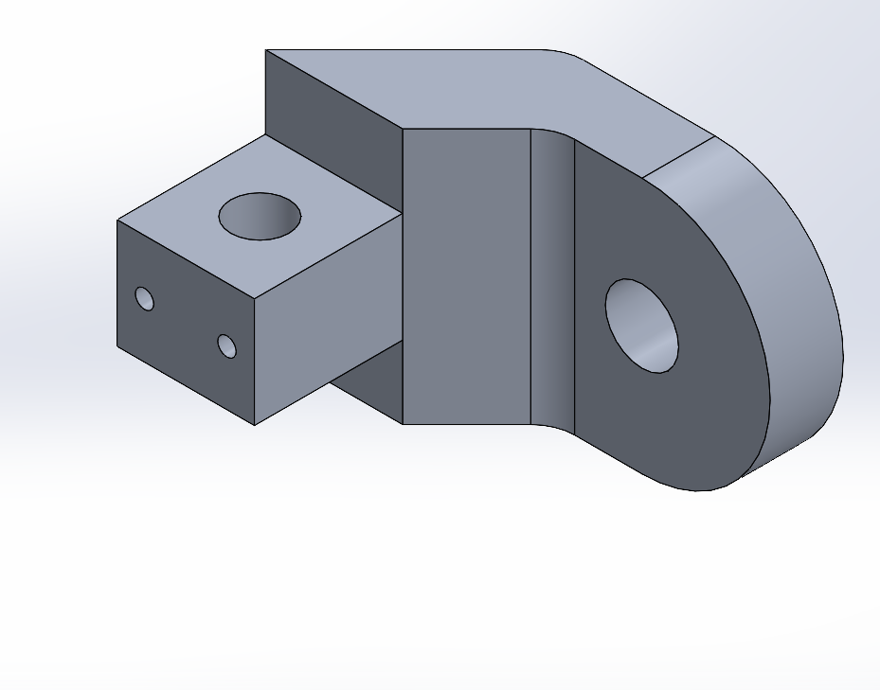
Knuckle Design
Upright
The Upper A-Arm connection point on the knuckle will be bolted on and secured to the knuckle base using dowel pins.

Slide 23
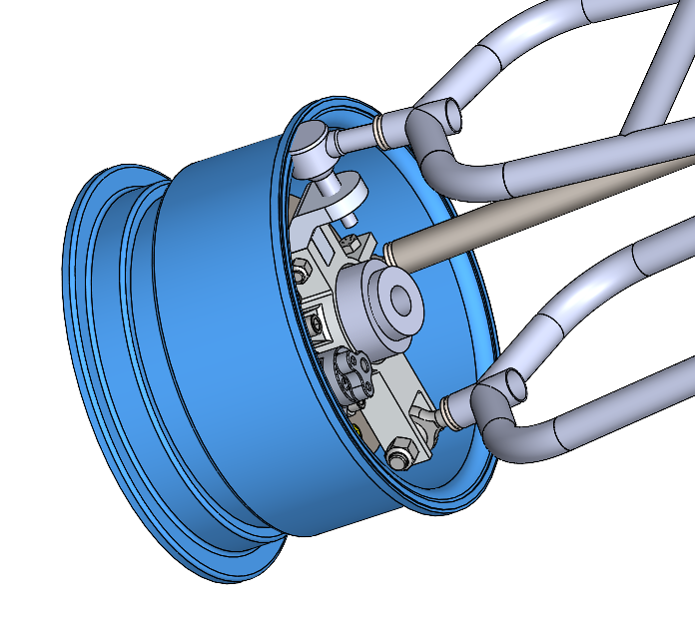
Knuckle Design
Design Issues
There is a clearance issue in the current knuckle
The Upper A-Arm Ball Joint interferes with the rim
Because the knuckle is set by the suspension geometry a slight oversight was made but it can be easily corrected with a small redesign

Slide 24
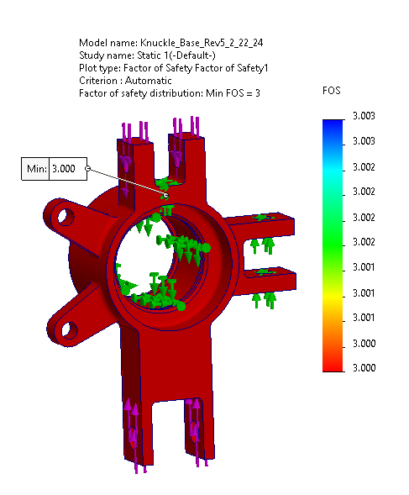
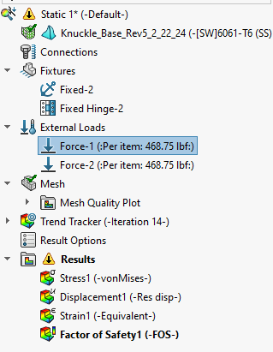
Knuckle Design

Slide 25
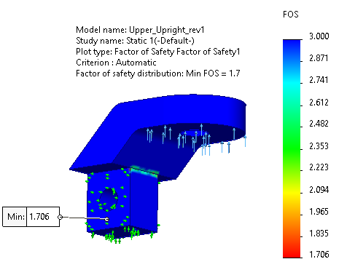
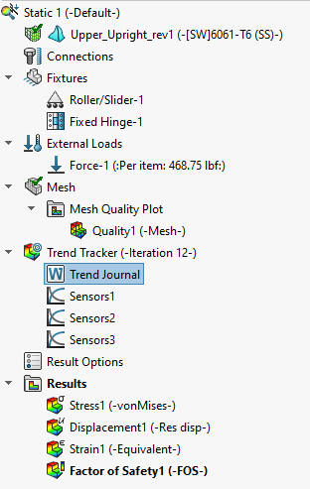
Knuckle Design

Slide 26
Quality Plan
Verify that all dimensions of machined parts are correct before assembling
  A-Arm lengths and bend angles
  Insert dimensions are correct
  Knuckle tolerances are correct for press fitting of bearing
First iteration shall be dimensionally verified
  All joints in knuckle assembly do not collide with brake rotor
  A-Arms fit into the tabs on the Jig and the Cowboy Racing Baja Car
Complete Weld tests to ensure that all welds are to Baja SAE Weld Standard
All tolerances are followed while machining per drawings

Slide 27
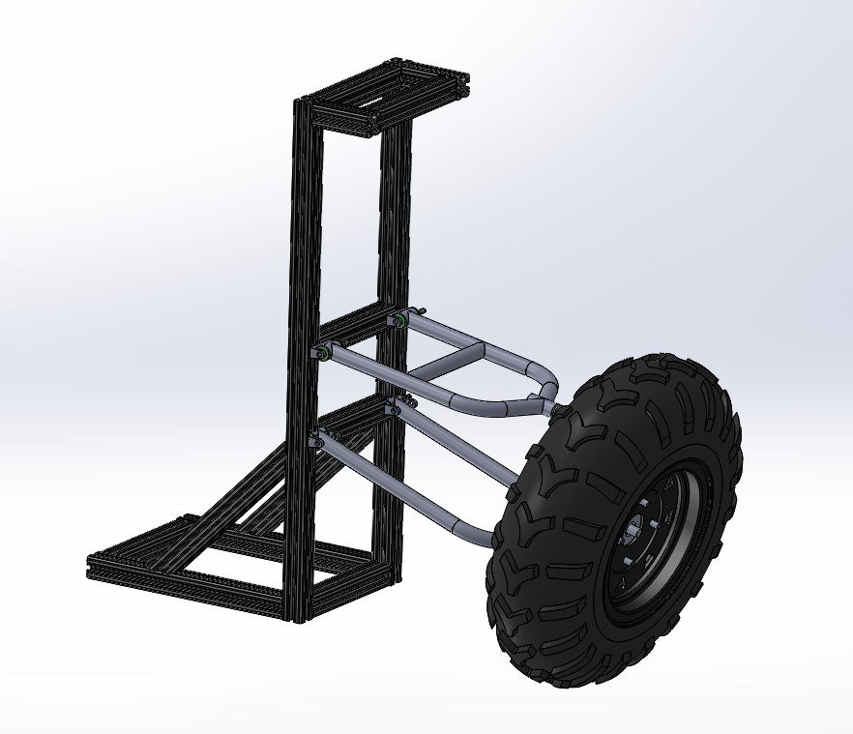
Testing
Jig Assembly

Slide 28
Testing
Jig Assembly
Jig is made out of 80/20 Aluminum
Load testing will be done on the A-Arms and the Knuckle
Jig will have pickup points of the Baja car
The shock will be replaced with 3 different lengths
  16.6 in, 12.9 in, and 18.2 in
  1.25x.065 Chromoly Tubing
The wheel will then be loaded till the shock bar reaches a strain equivalent of 187.5 lbs of wheel loading
Strain gauges will measure the strain on the A-Arms and the Knuckle
A factor of safety will be calculated from the strain values

Slide 29
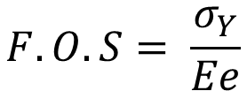
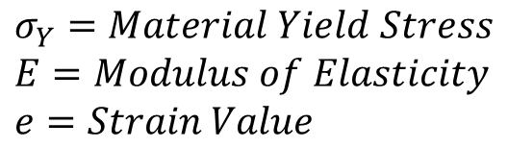
Testing
Jig Assembly
Test Number | Test 1 | Test 2 | Test 3
Test Description | Use 16.6 in Shock Bar to measure the strain of the Knuckle, Upper, and Lower A-Arms at static loading shock length | Use 12.9 in Shock Bar to measure the strain of the Knuckle, Upper, and Lower A-Arms at full compression shock length | Use 18.2 in Shock Bar to measure the strain of the Knuckle, Upper, and Lower A-Arms at full extension shock length
Use most critical strain values to calculate factor of safety shown in the equation below
$$F.O.S= \frac{σ_{Y}}{Ee}$$
$$σ_{Y}=Material Yield Stress$$
$$E=Modulus of Elasticity$$
$$e=Strain Value$$
Pass > 1.25

Slide 30
Testing
Baja Car Testing
Driver Comfort
  Cowboy Racing and Senior Design Differences
    Suspension Geometry
    Steering Geometry
    Compare new setup with current setup
  2011 vehicle

Slide 31
Costs
Total Projected Expenses: $4200
BREAKDOWN
OEM: $1305.98
Manufacturing: $92.24
Joints: $578.30
Fasteners: $276.49
Materials: $1706.19

Slide 32
Costs
Final Asking Budget With 50% Contingency:
$6300
Assumed Donation of FinishLine Tubing From Webco Would Lower Expenses By -$750

Slide 33
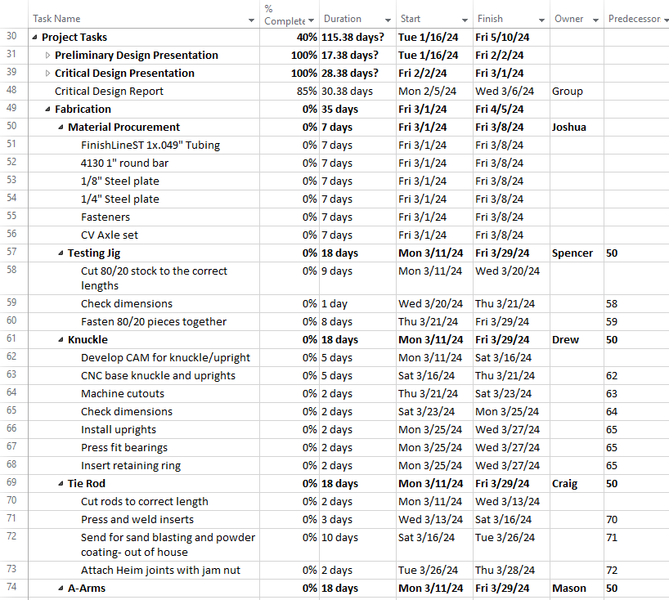
Project Plan

Slide 34
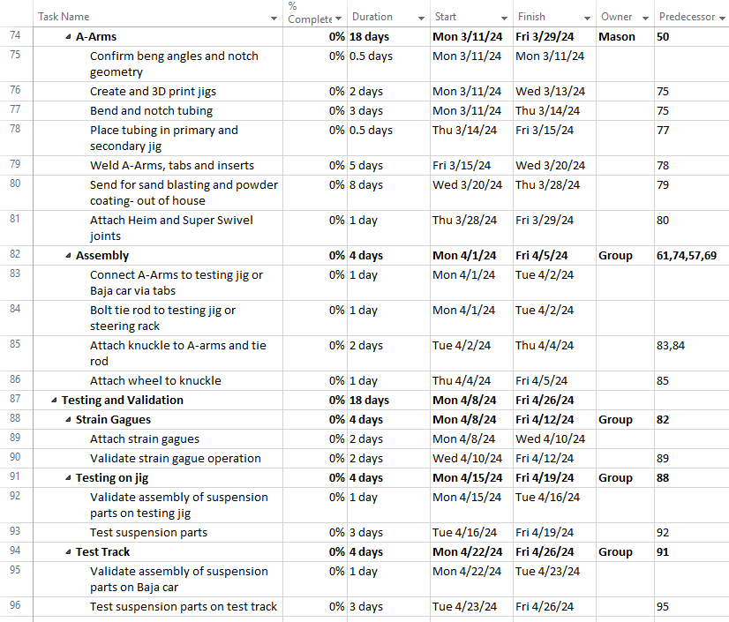
Project Plan

Slide 35
Work Breakdown Overview
Drew Milligan – Knuckle Design, FEA, Suspension Geometry
Mason Hagelberg – Knuckle Design, BOM/Costs
Joshua Davies - Project Plan, Material Selection, Quality and Testing
Craig Mullarkey – Suspension Geometry, Quality and Testing
Spencer Swanson – Jig Design, CAD Assembly

Slide 36
Any Questions?

Slide 37
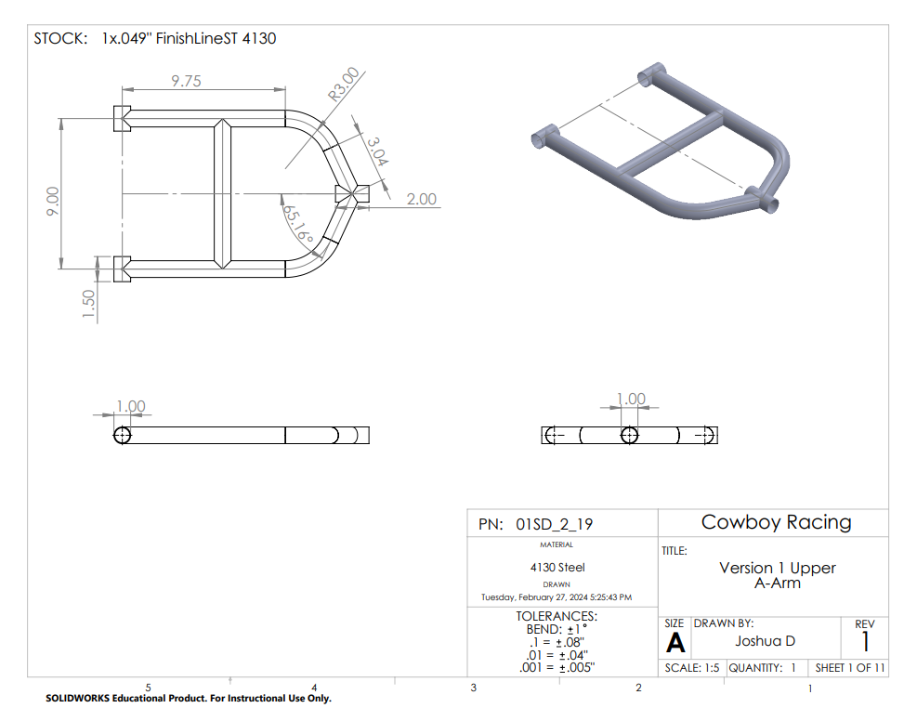

Slide 38
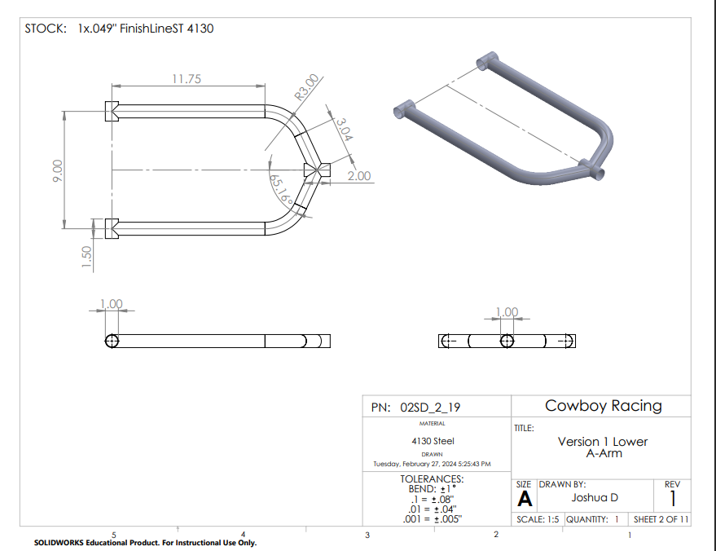

Slide 39
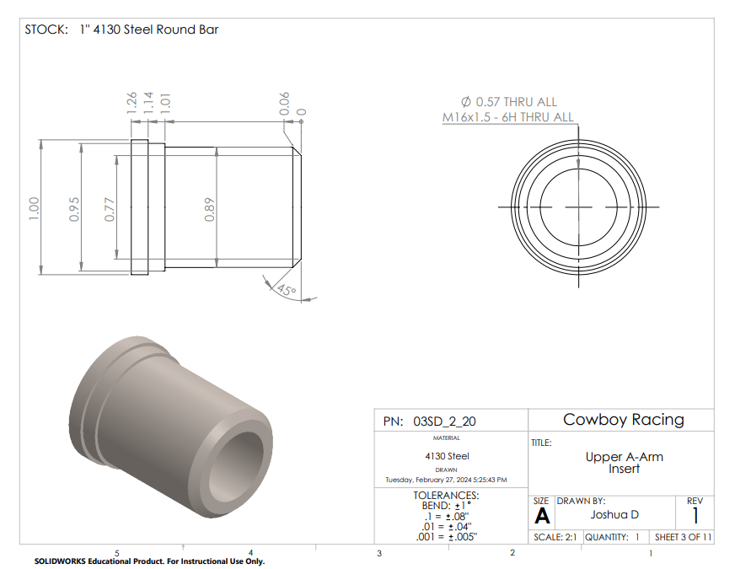

Slide 40
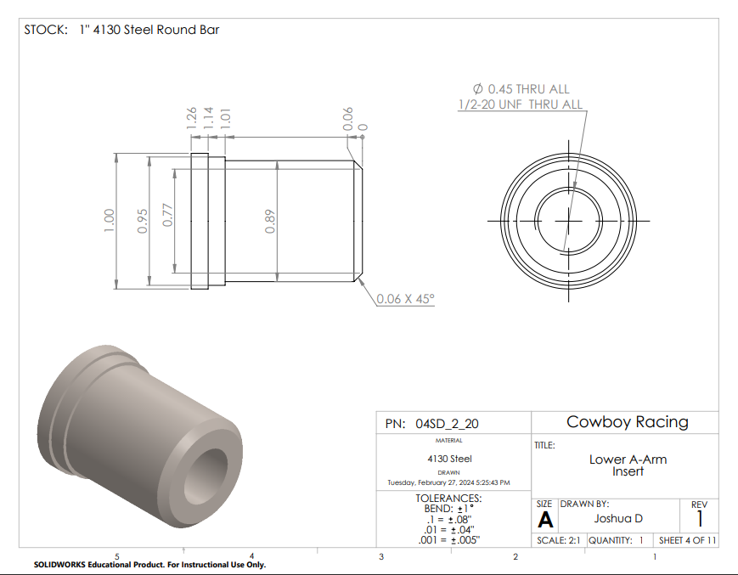

Slide 41
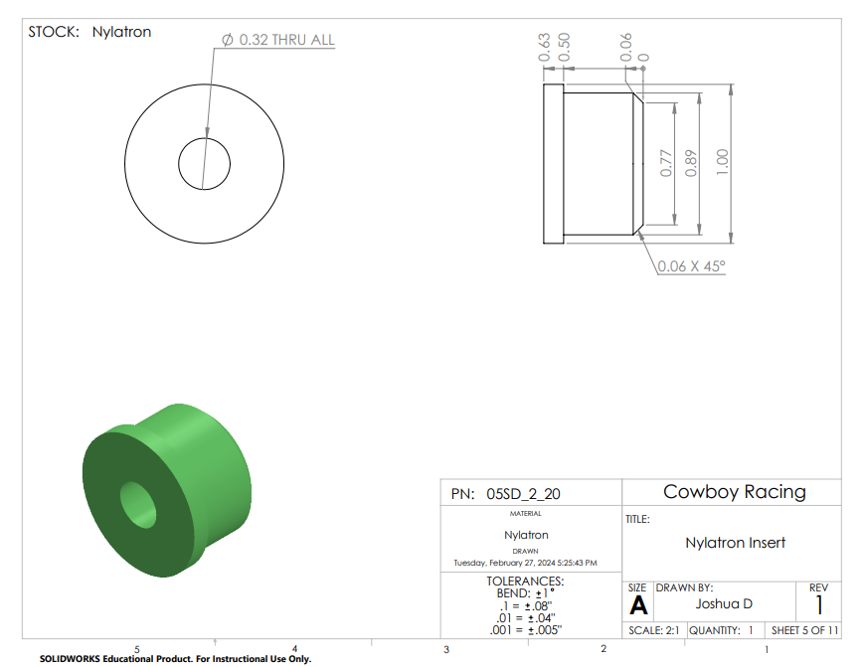

Slide 42
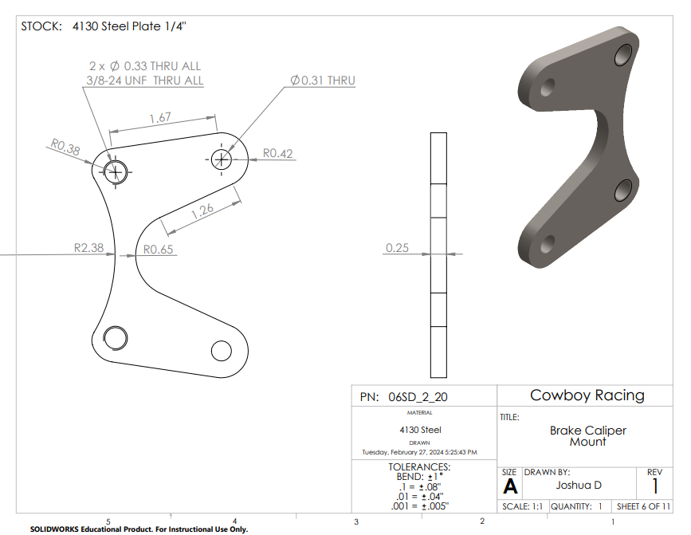

Slide 43
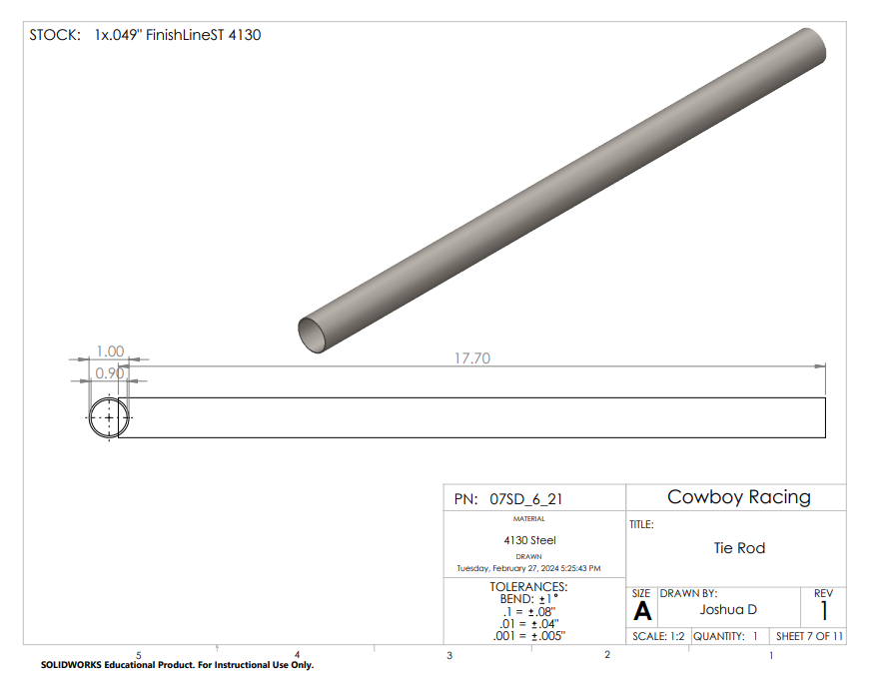

Slide 44
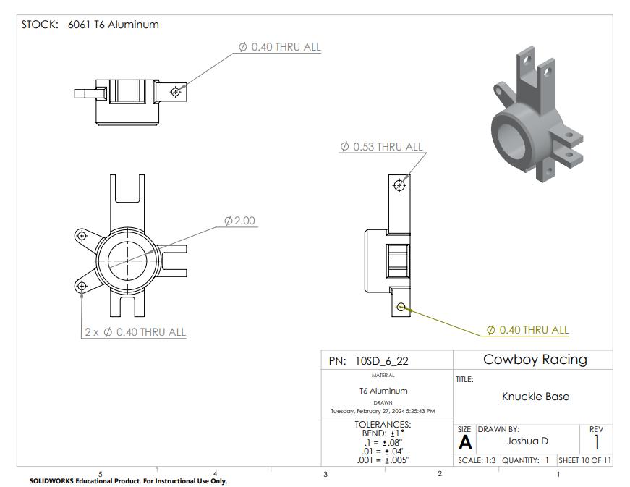

Slide 45
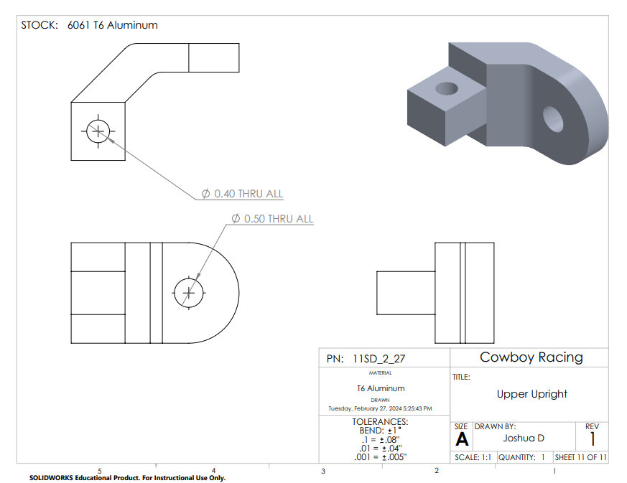

Slide 46
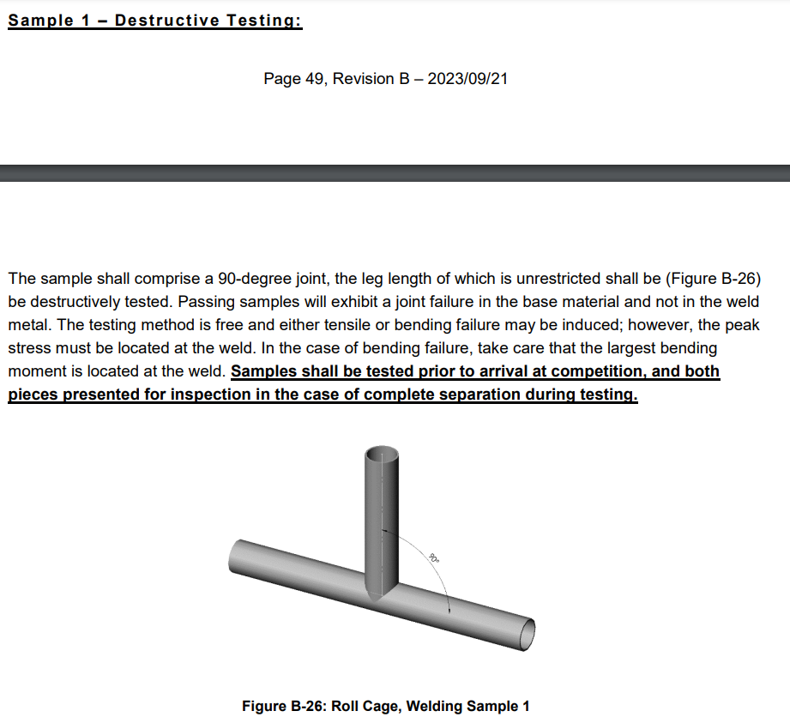

Slide 47
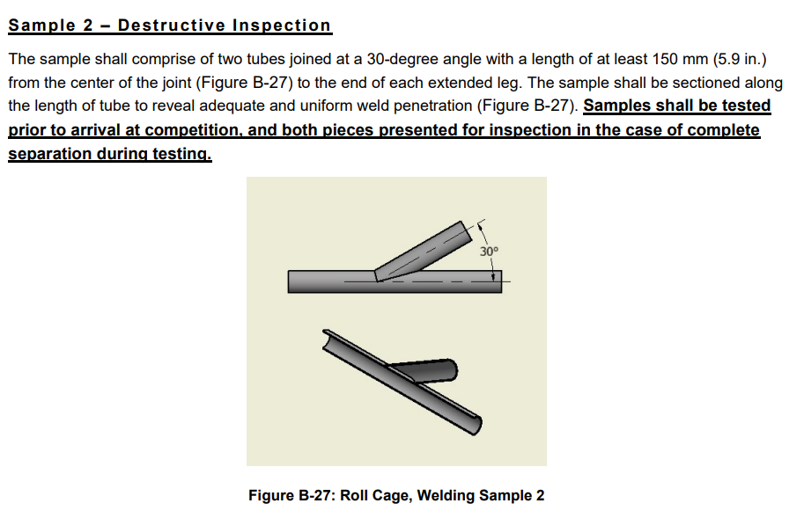

Slide 48
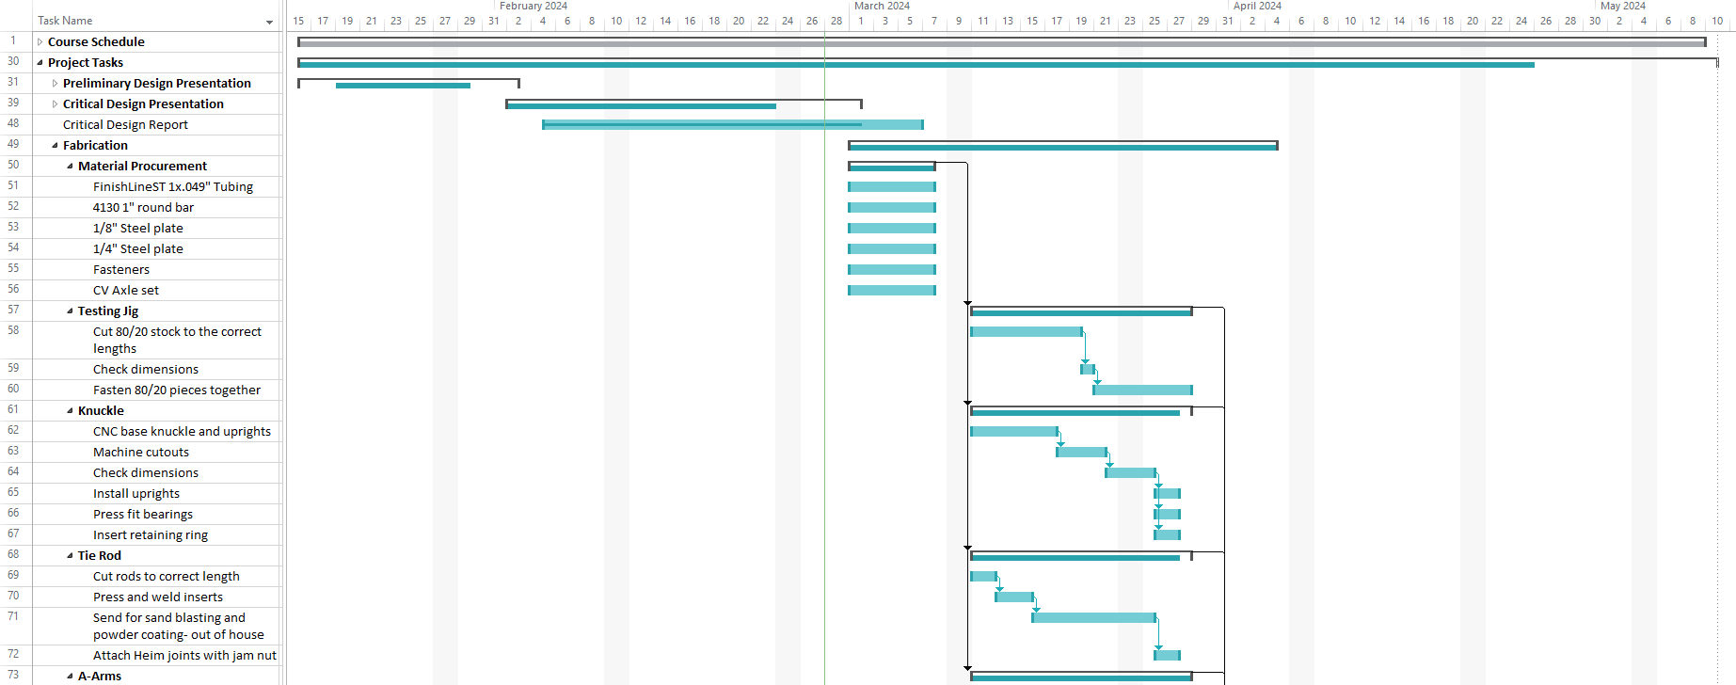

Slide 49
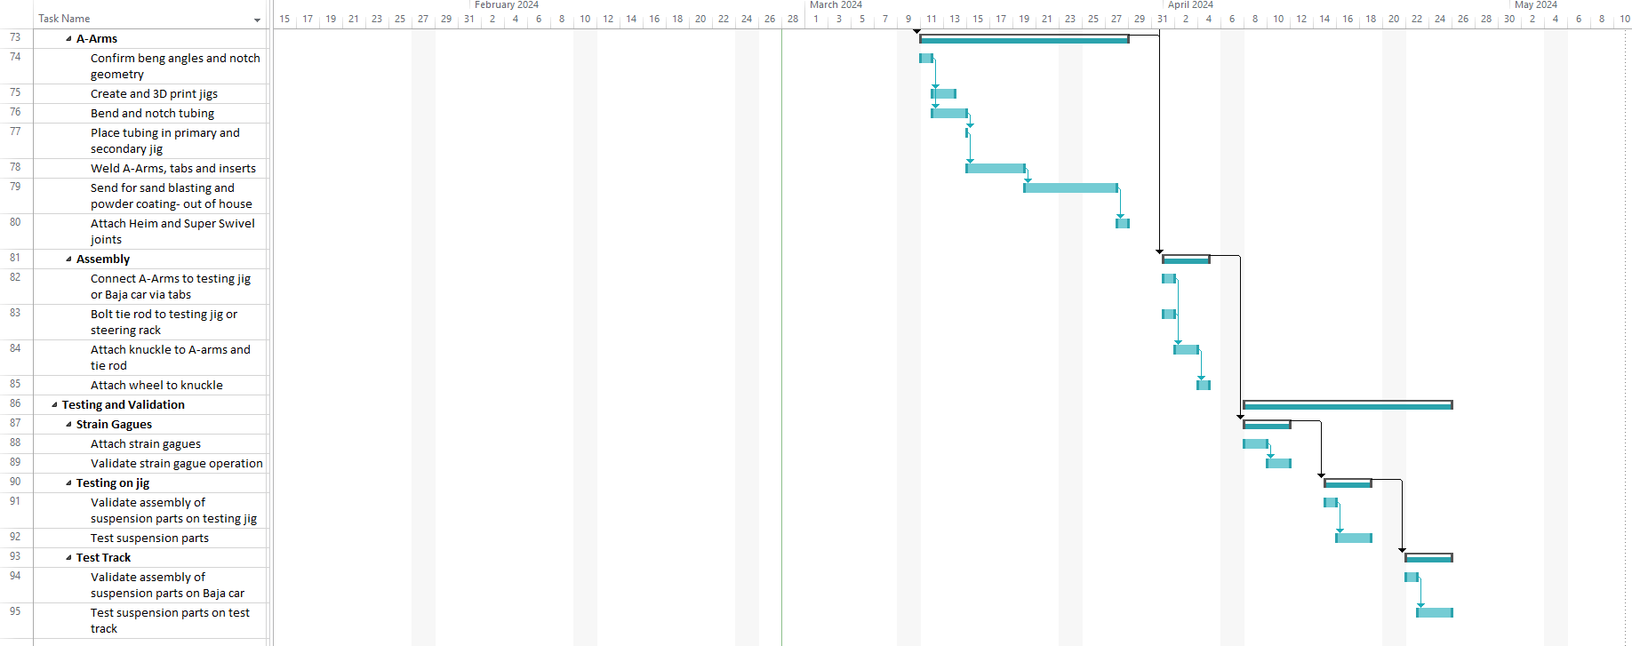

Slide 50

