Slide 1
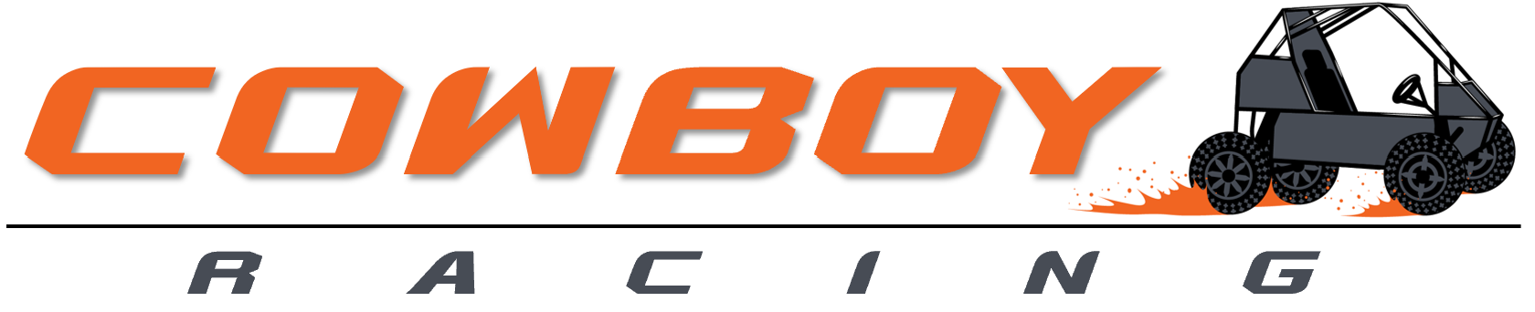
Creating Excellence in Design, Build, and Drive since 1995
Baja Front Suspension

Slide 2
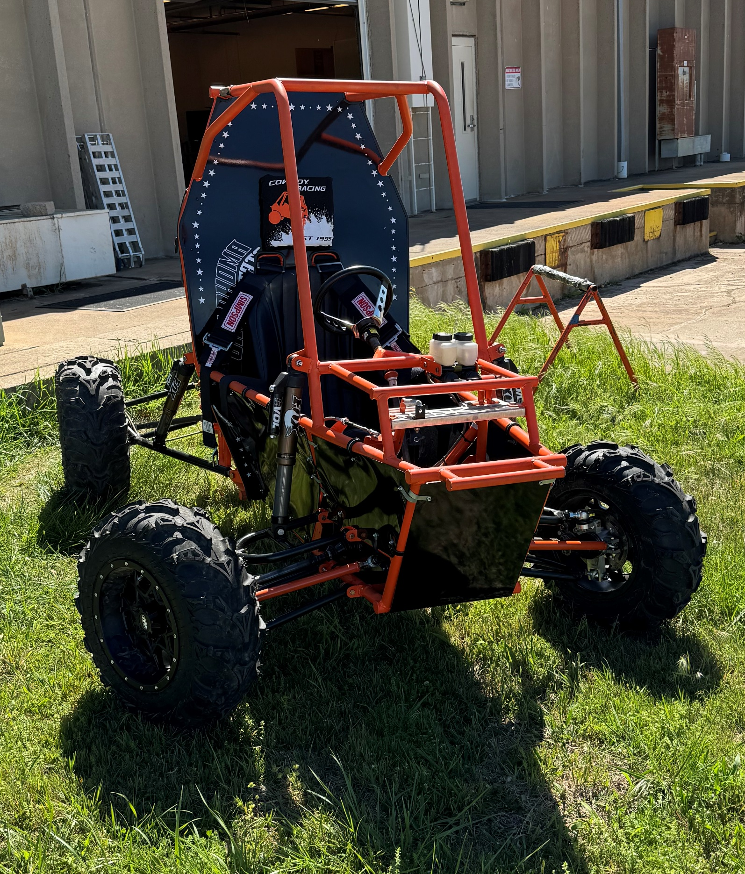
Team Introduction
Drew Milligan – Team Lead B.S. Mechanical Engineering
Mason Hagelberg – Purchaser B.S. Mechanical Engineering
Joshua Davies - Team Planner B.S. Mechanical Engineering
Craig Mullarkey – Testing Lead B.S. Mechanical Engineer
Spencer Swanson – CAD Lead B.S. Mechanical Engineer

Slide 3
Problem Description
Design and develop a front suspension system for the 2023-2024 Cowboy Racing Mini Baja Car that maximizes the strength to weight ratio, minimizes unsprung weight, and has suitable geometry for off road vehicles.

Slide 4
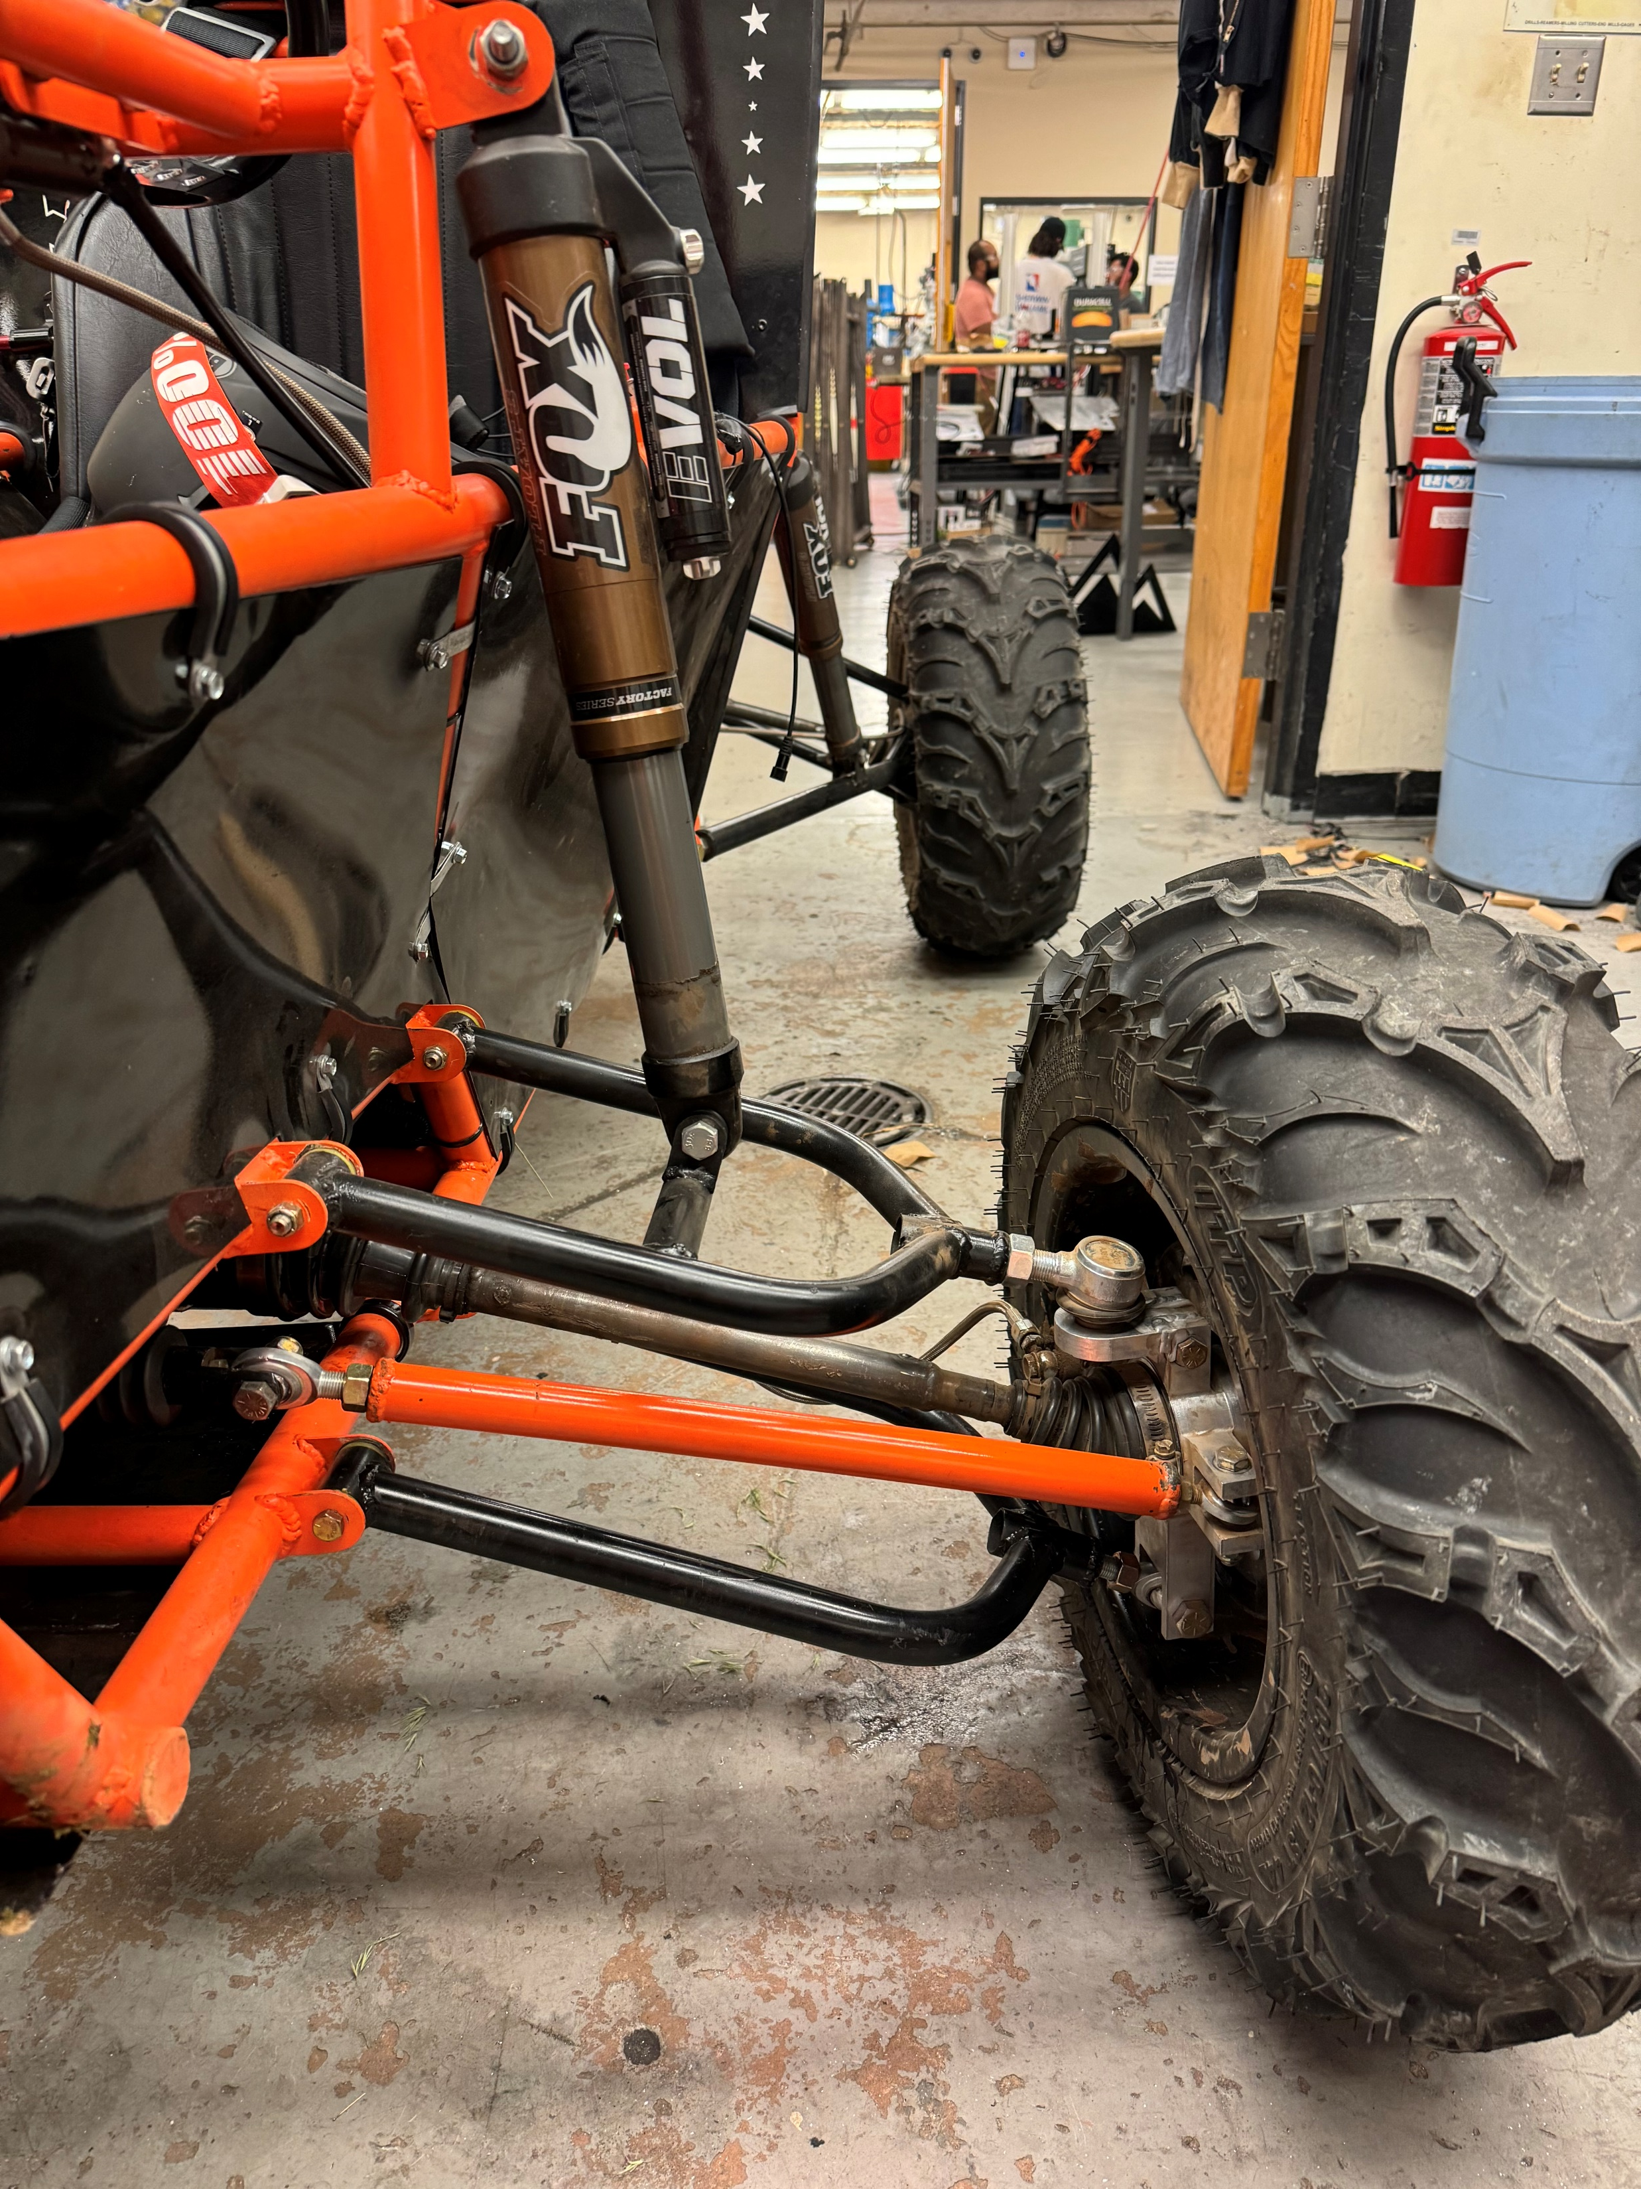
Overall Solution
Material Selection
Suspension Geometry
  A-Arms
  Fasteners and Inserts
Knuckle Design

Slide 5
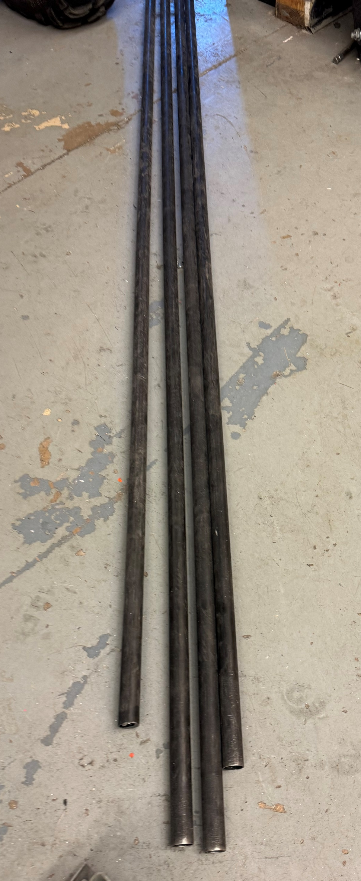
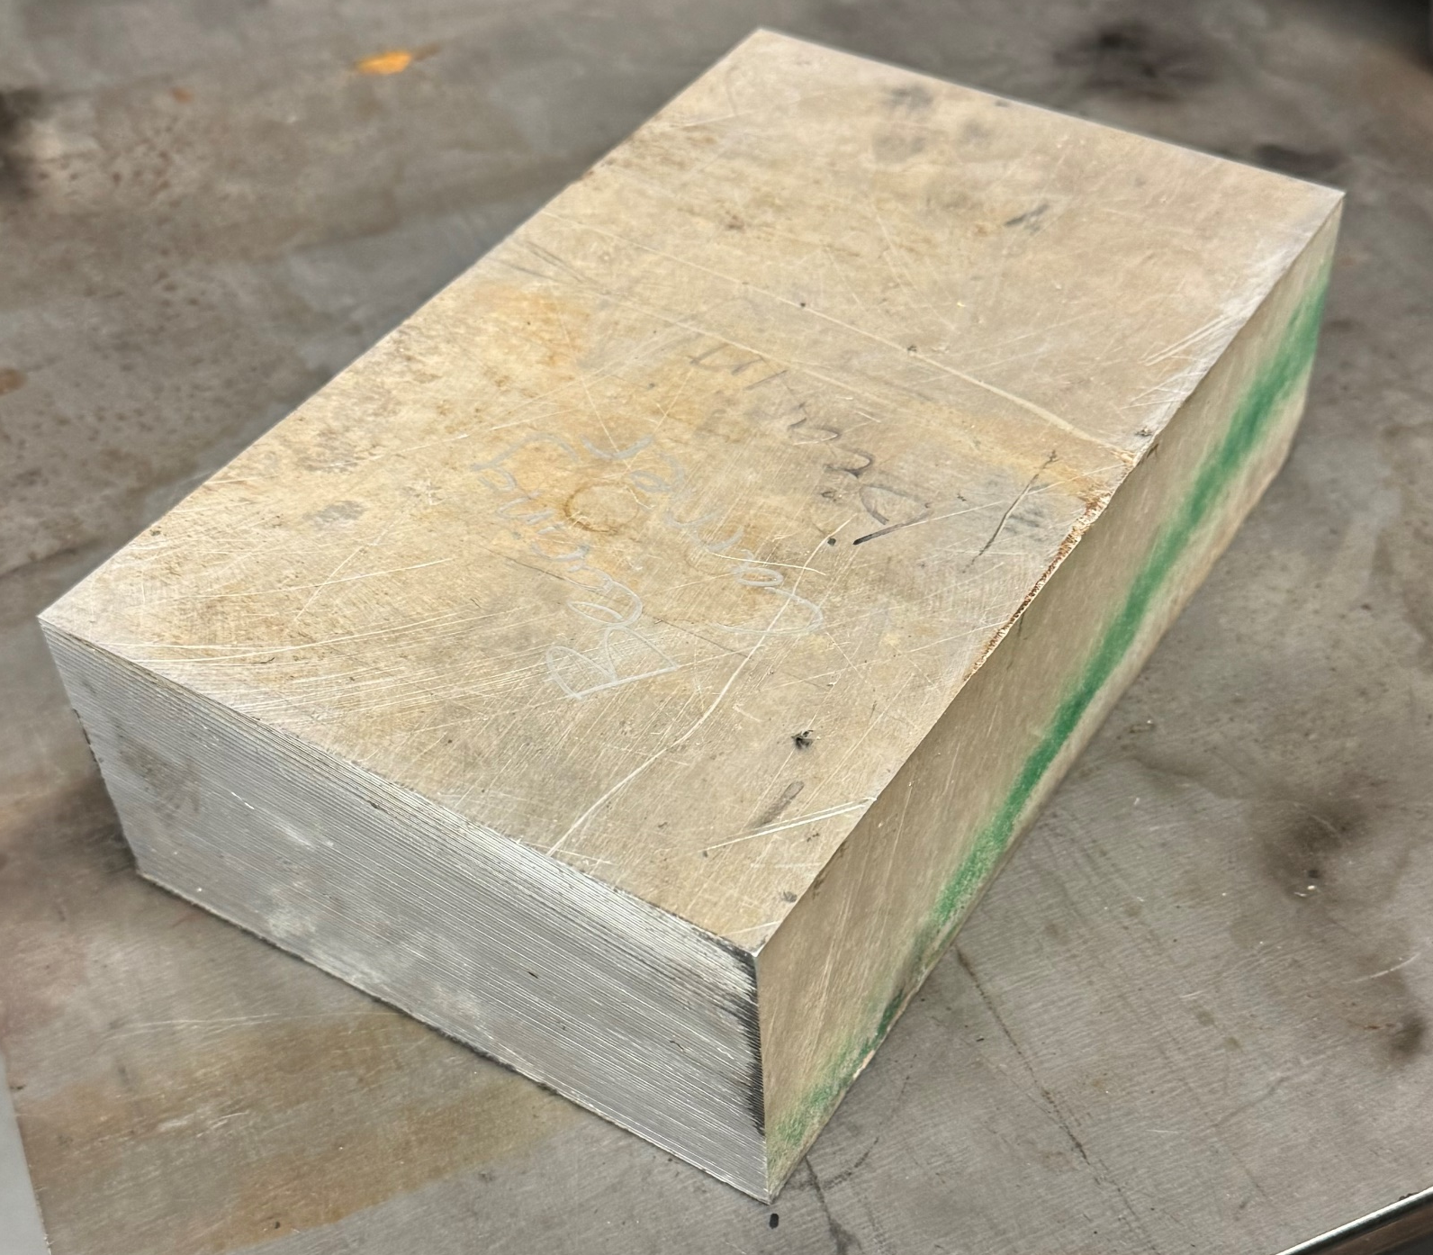
Material Selection
A-Arms: FinishLineST™ 4130 Steel Tubing 1x.049”
  Greater strength to weight than Chromoly
Knuckles: 6061 T6 Aluminum
  Greater strength to weight than cast iron

Slide 6
Suspension Geometry
Optimized the suspension based on the following values
  Total Width: ≤ 64 in
  Roll Center distance to the Center of Gravity: < 10 in
  Scrub Radius: < 1 in
  Variable Camber: < 20 in
Values provide the Baja car with optimal off-road suspension performance
Actual values achieved

Slide 7
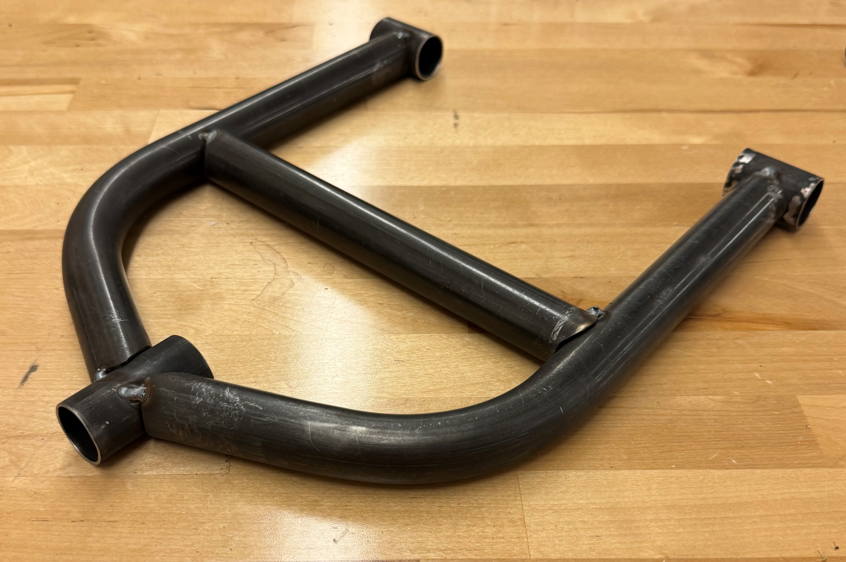
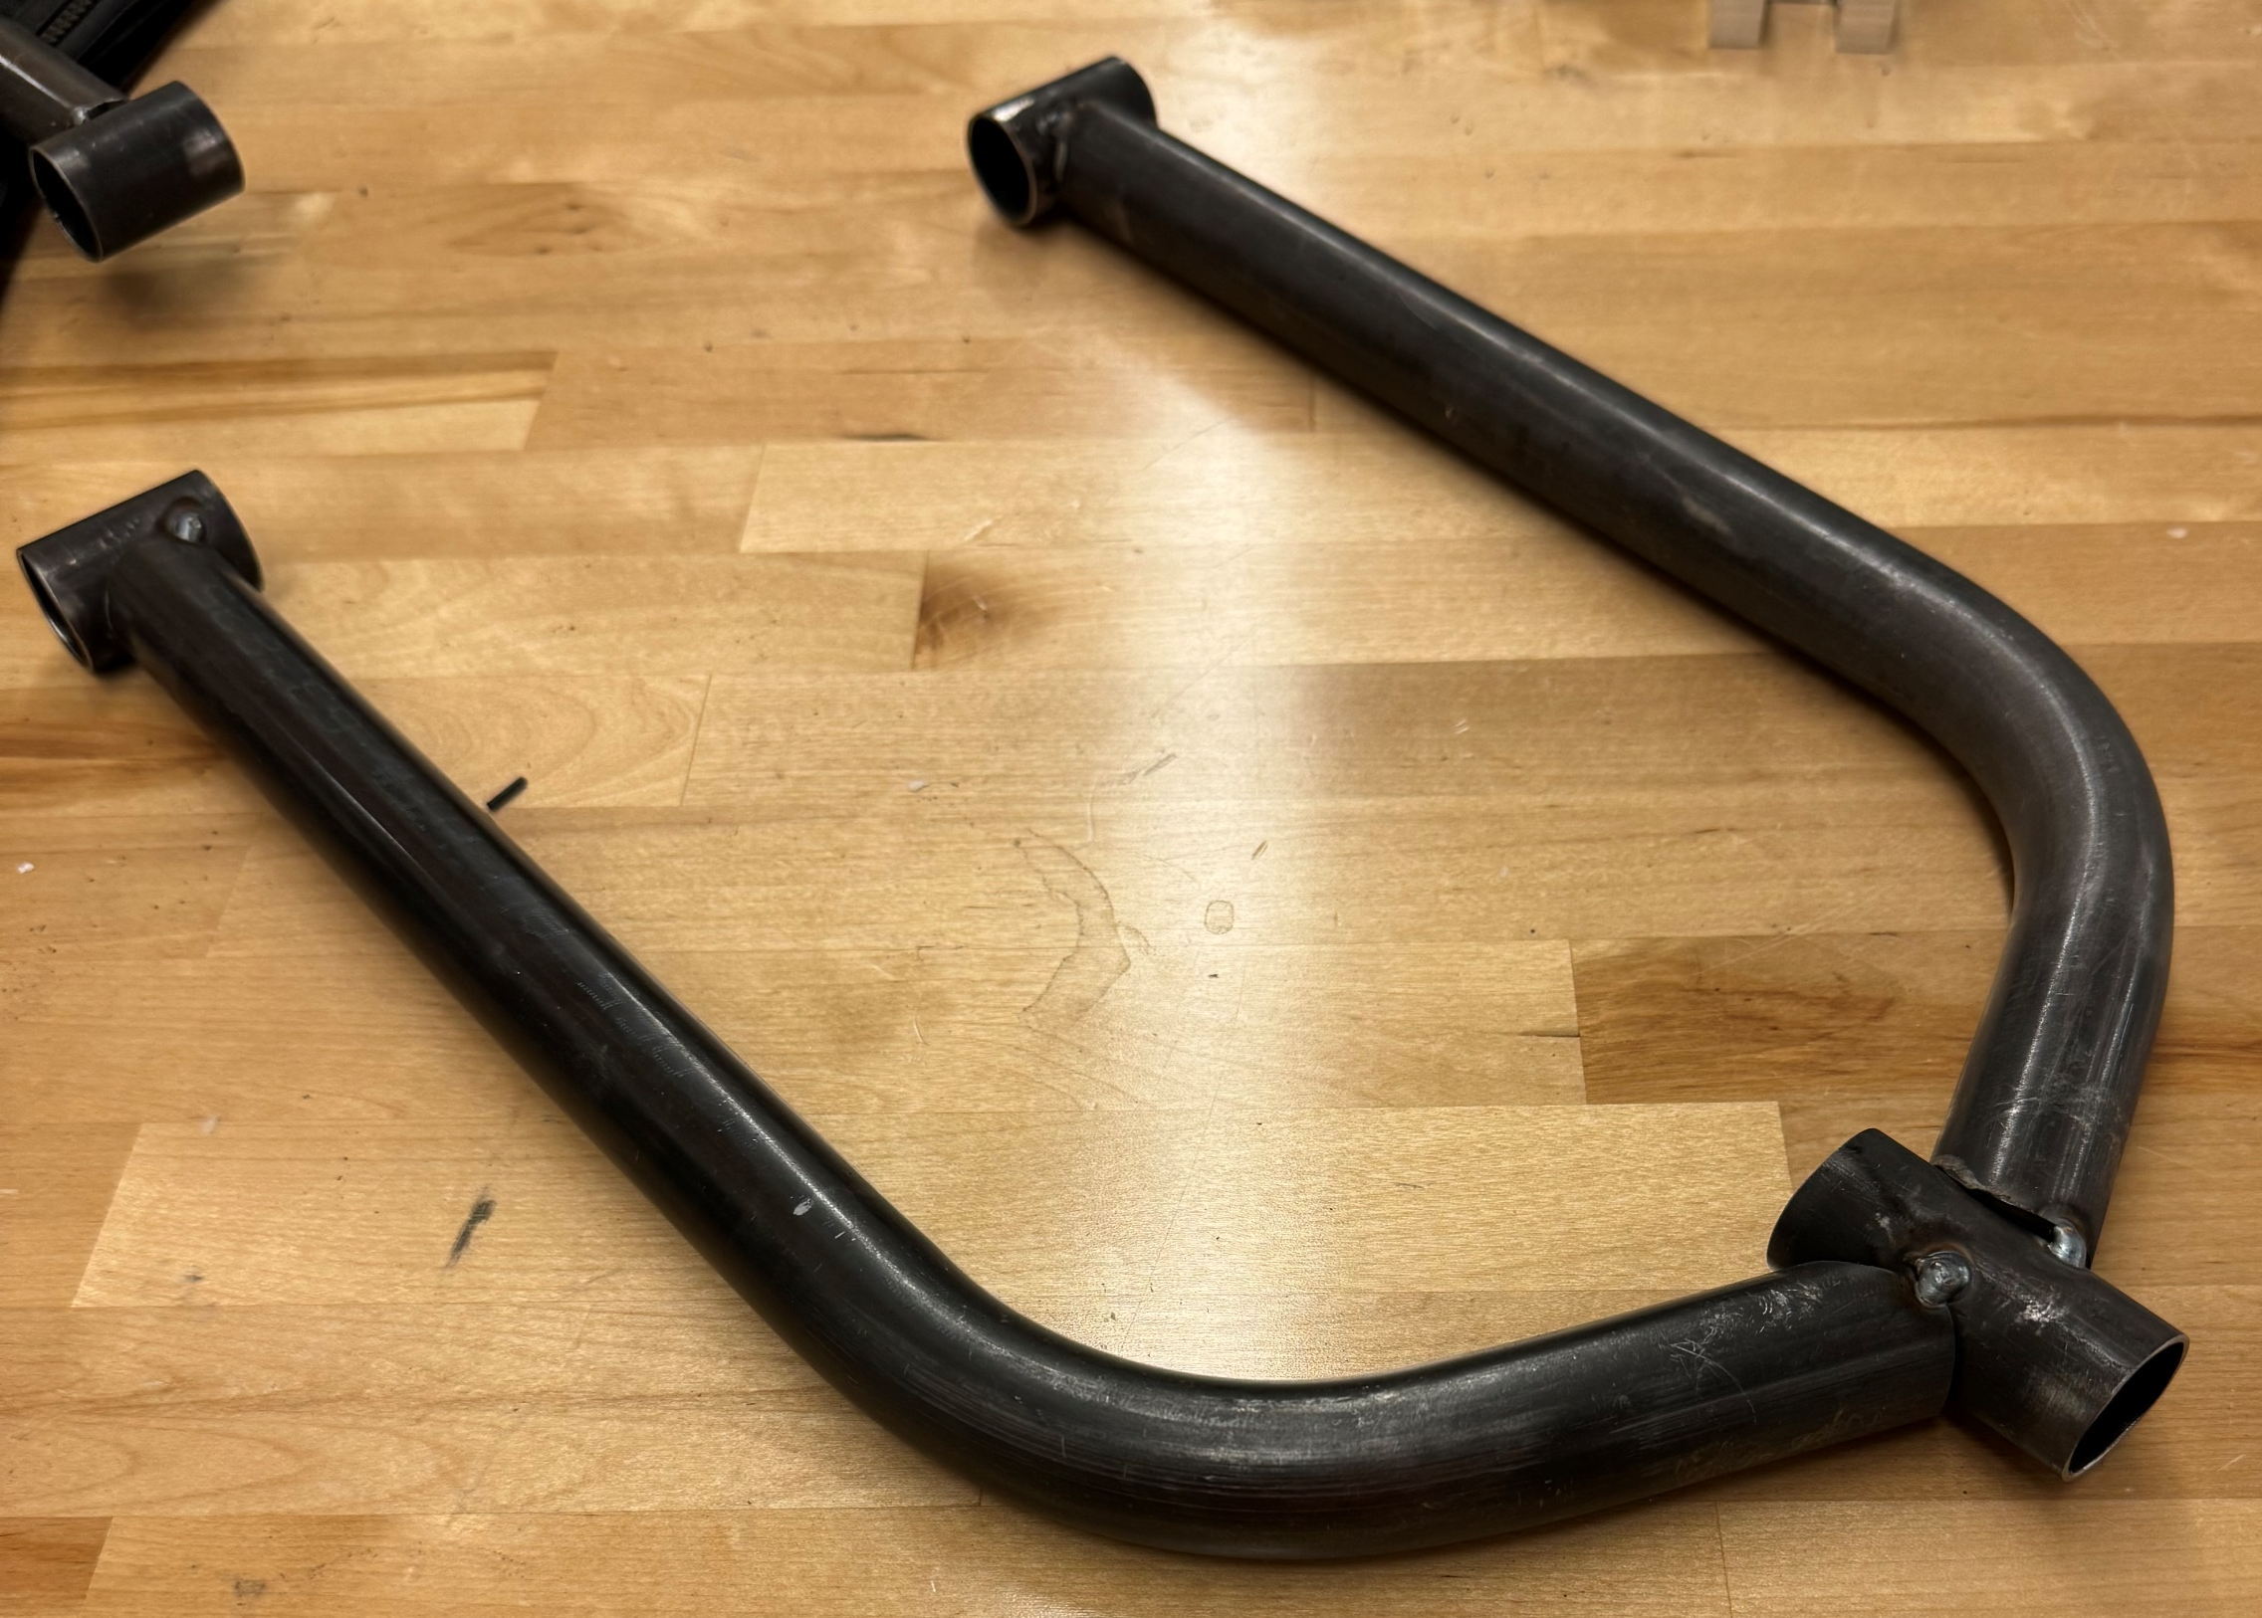
Suspension Geometry
A-Arms
Upper
Lower

Slide 8
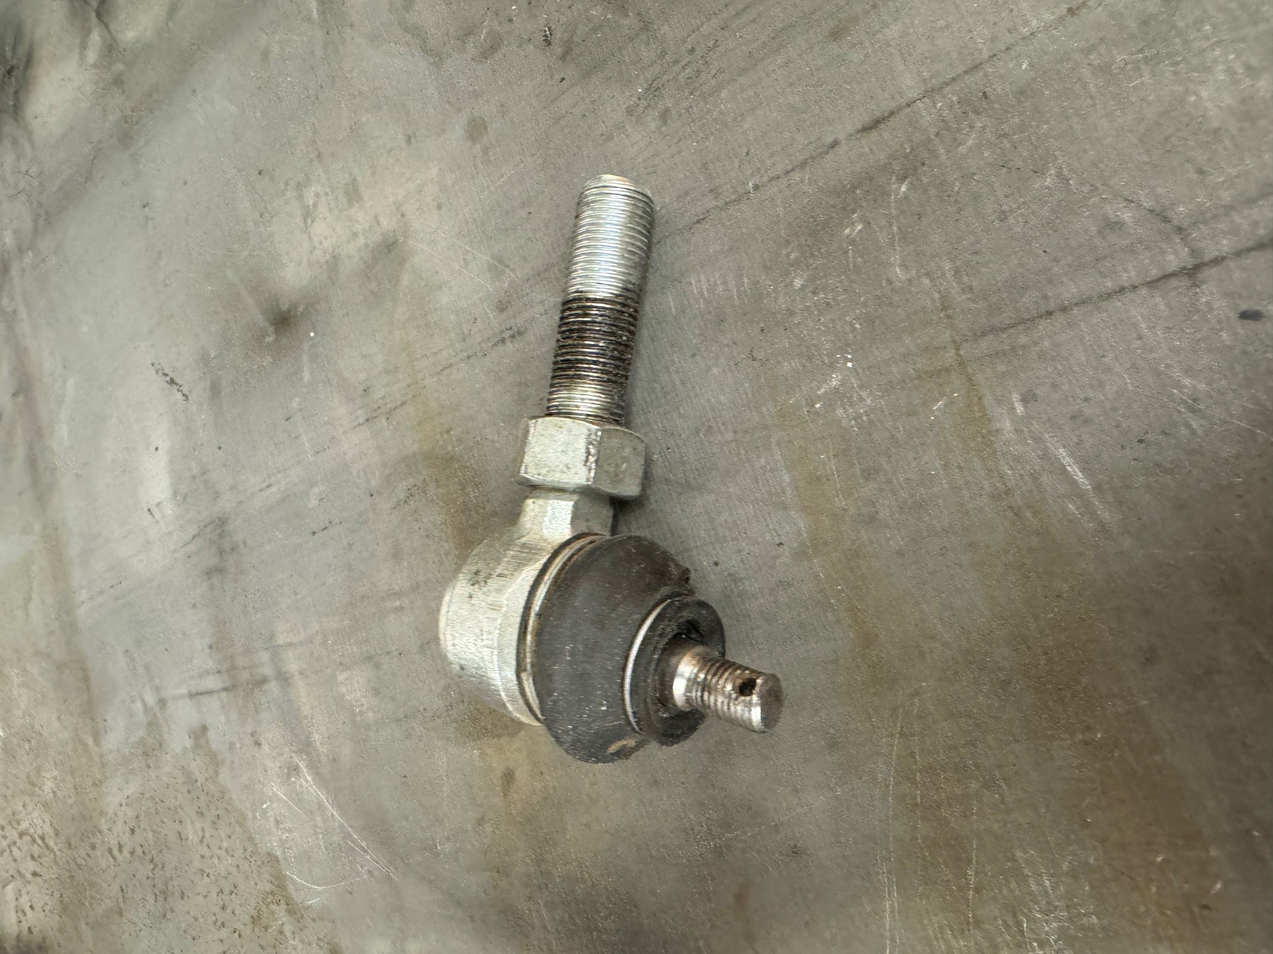
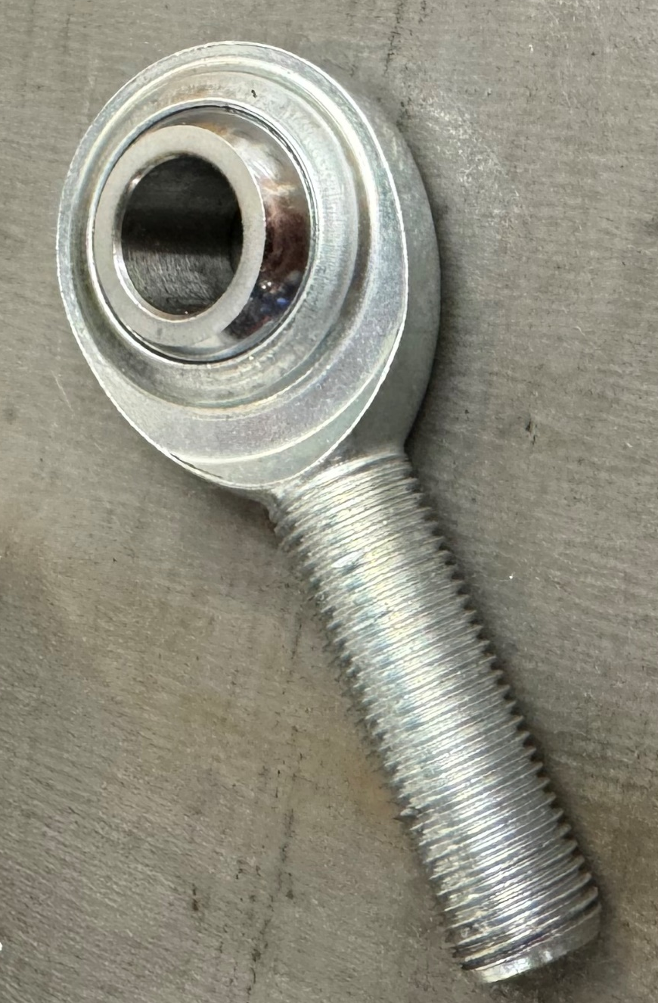
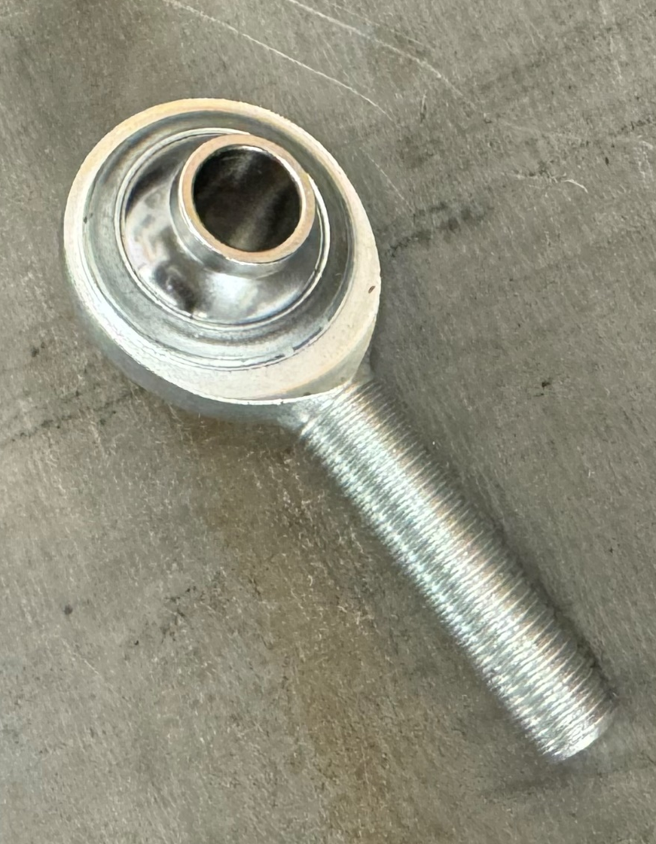
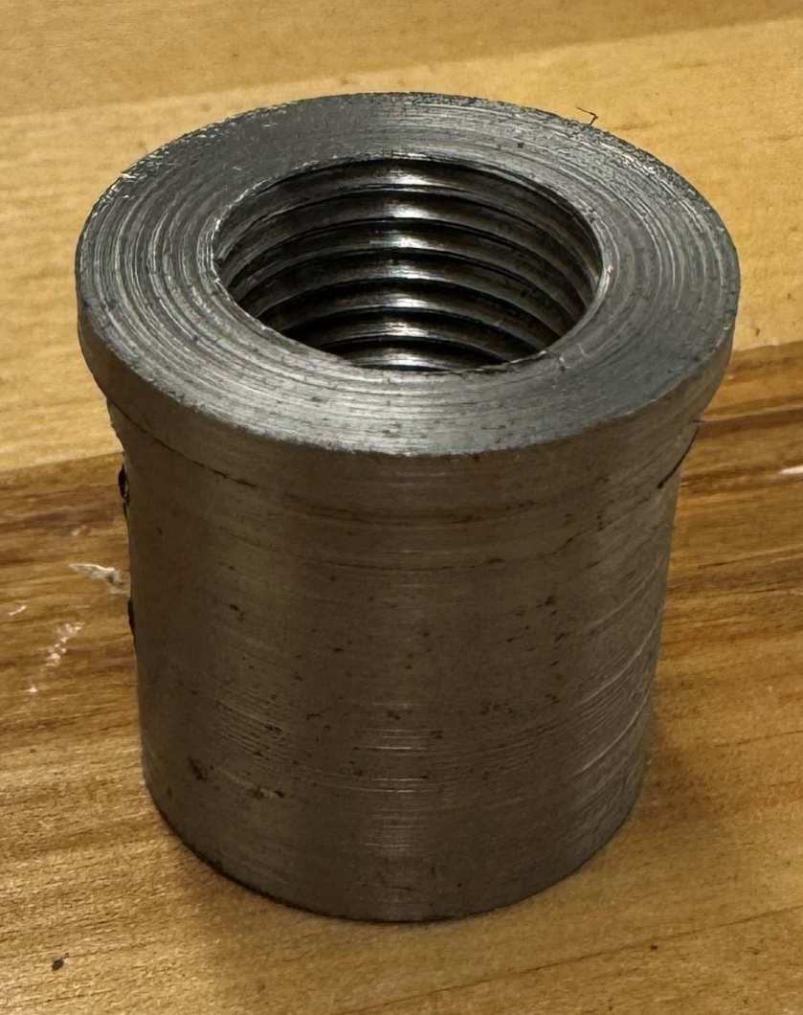
Suspension Geometry
Fasteners and Inserts
Ball Joint
Heim Joint
Super Swivel Heim Joint
Insert

Slide 9
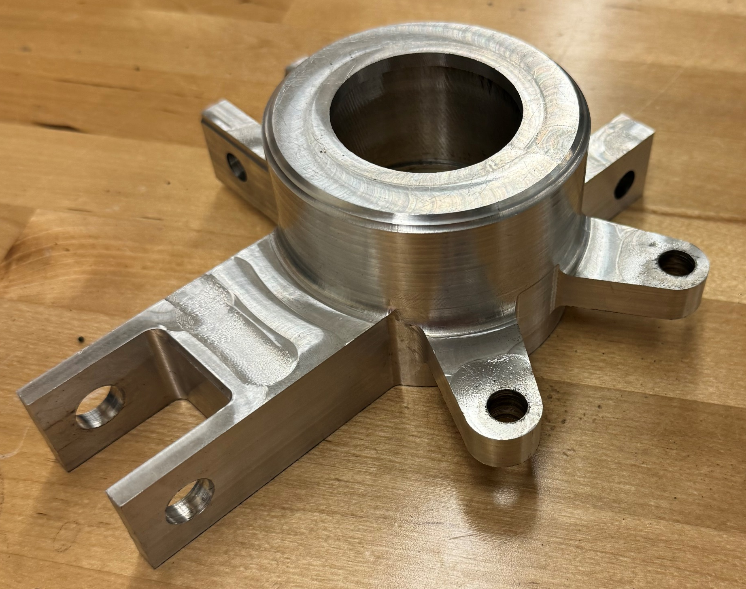
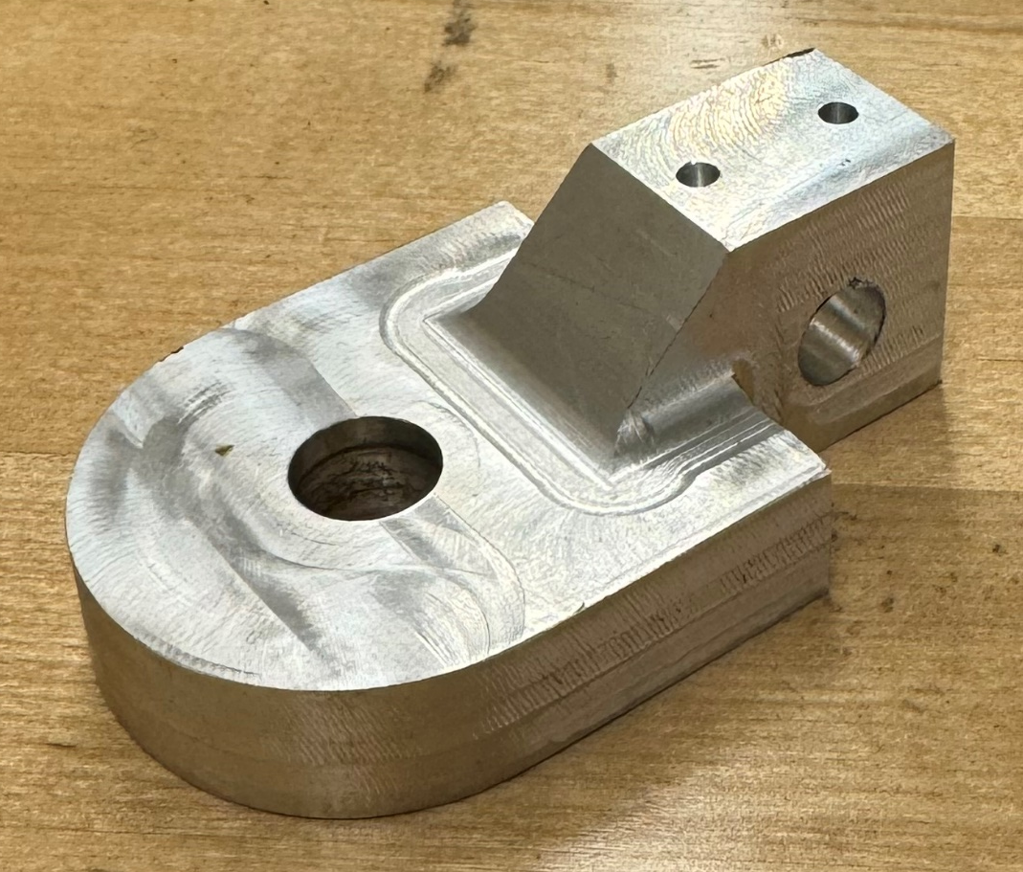
Knuckle Design
Geometry of knuckle set by suspension geometry
Two-piece design: knuckle base and upright
  Upright will be aligned using dowel pins, bolted, and welded to the knuckle base
Interfaces with the tie rod, A-Arms, and wheel hub
Upright
Knuckle Base

Slide 10
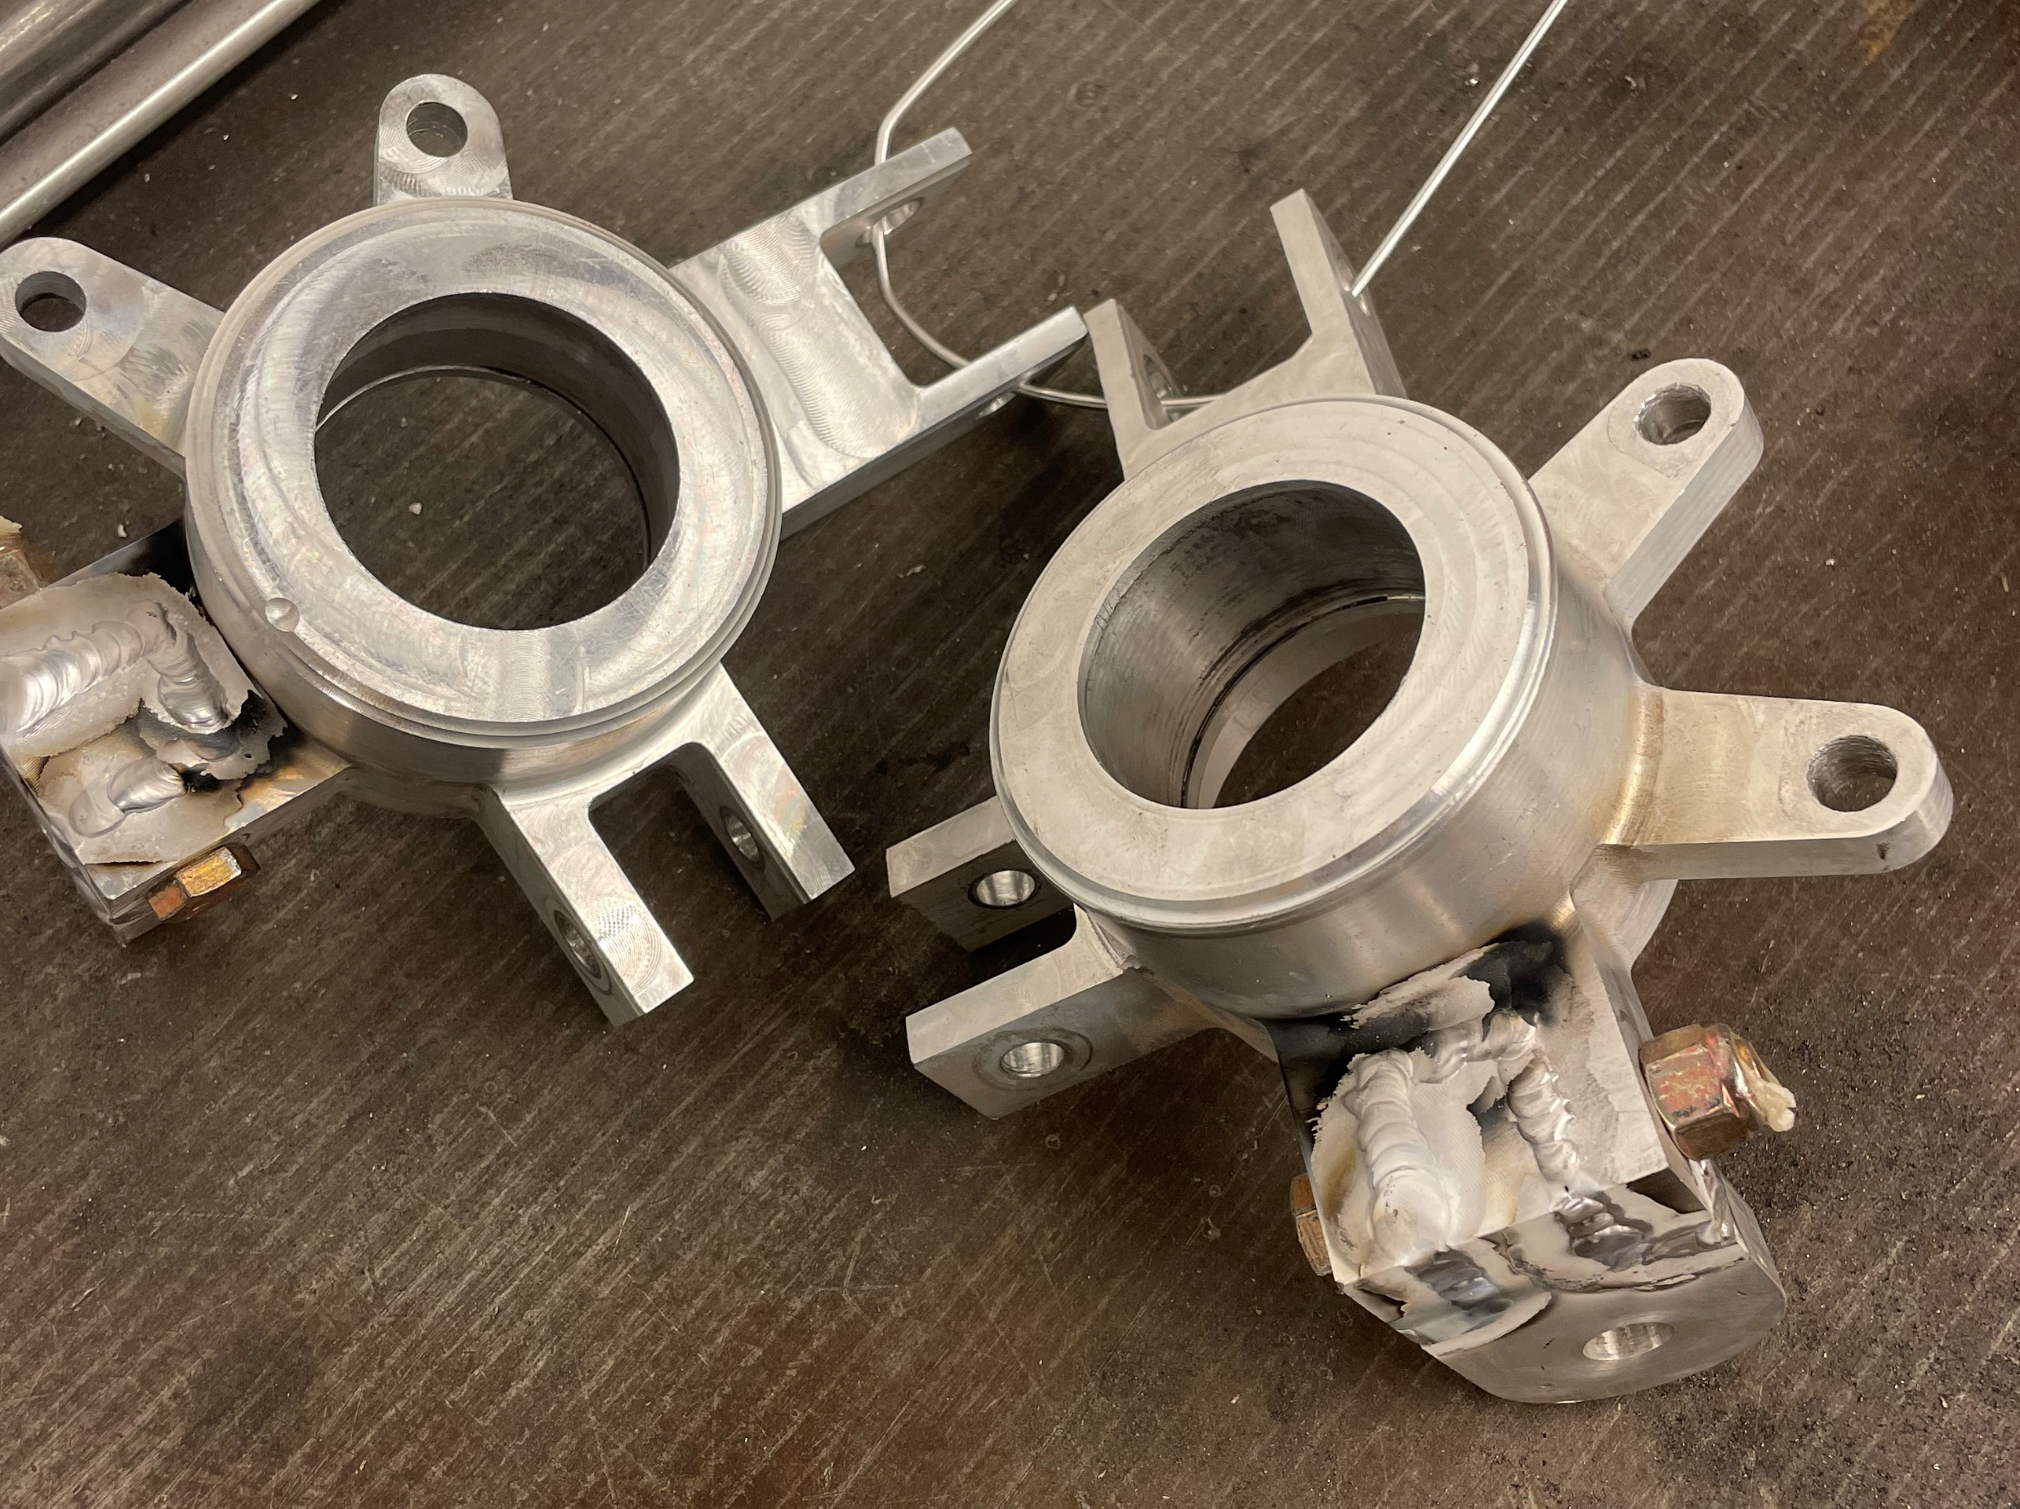
Knuckle Design

Slide 11
Engineering codes, standards, and guidelines
Baja SAE 2024 Rules
  Establishes rules regarding suspension constraints and welding tests
ASTM A450
  Standard Specification for General Requirements for Carbon and Low Alloy Steel Tubes
SAE International
  Establishes uniform engineering nomenclature for suspension systems and their components used on passenger cars, light trucks, and multipurpose vehicles
Fundamentals of Vehicle Design, Race Car Vehicle Design, Shigley's Mechanical Design Textbook, Chassis Design: Principles and Analysis
  Guided design decisions for suspension geometry, A-Arm design, and knuckle design

Slide 12
Engineering and other analysis
Material Selection
Suspension Geometry Design
Steering Geometry Design
Knuckle FEA

Slide 13
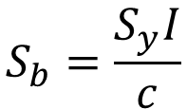

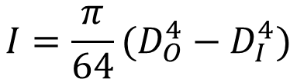
Material Selection
$$I=\frac{π}{64}(D_{O}^{4}−D_{I}^{4})$$
$$k_{b}=EI$$
$$S_{b}=\frac{S_{y}I}{c}$$
Calculated bending stiffness and bending strength
  Primary forces in double A-Arm suspension are bending forces
  Called out in Baja rulebook to certify materials

Slide 14
Suspension Geometry Design
2D Suspension Geometry Design
Iterated through 2D suspension geometry model to find different suspension geometry settings and their criteria listed below
  Distance from roll center to center of gravity
  Scrub radius
  Ground clearance
  Static camber
  Static toe
  Variable camber
Tested 6 different A-Arm lengths and altered KPI so camber was as close to 0º as possible and scrub radius to be as small as possible
On each of the A-Arm lengths we iterated the shock location and knuckle diameter and recorded the values above
After testing, we decided on the design that had the overall best combination of total width, roll center distance to center of gravity, wheel travel, and scrub radius

Slide 15
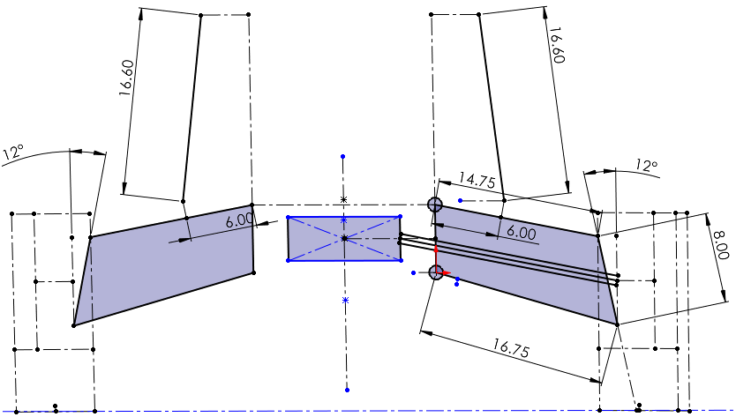
Suspension Geometry
Shock length
Upper A-Arm length
Frame to shock pickup length
Lower A-Arm length
KPI angle
Upper to lower pickup length

Slide 16
Suspension Geometry Design
Optimum Kinematic Simulations
Created 3D models based on the 2D suspension design models and data points of the Baja Car
3 front suspension models of our selected designs were created, and a rear suspension model was created to run simulations on
For the simulations we decided to focus on body roll and steering at the maximum values possible by the Baja Car
Ran the simulations and acquired data for each of the suspensions based on the following values
  Total width
  Roll center distance to the center of gravity in the Z-axis
  Scrub radius
  Variable camber

Slide 17
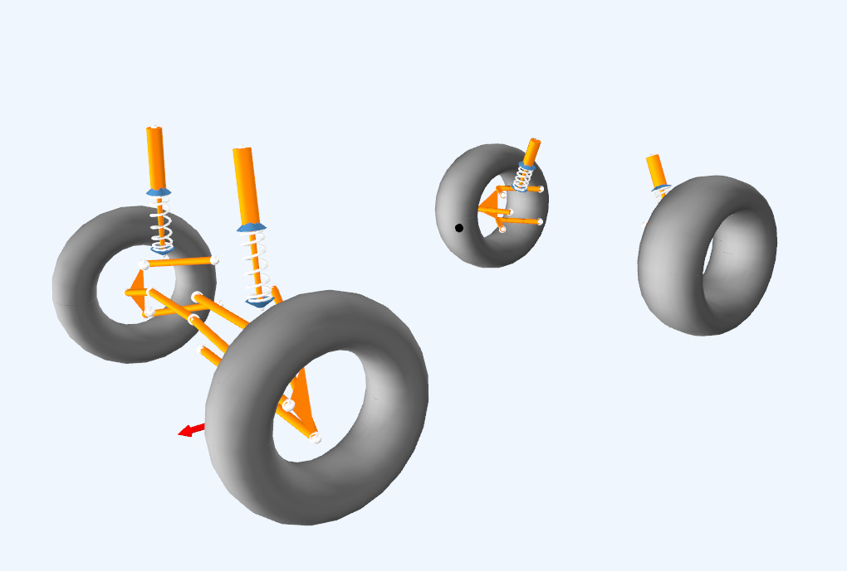
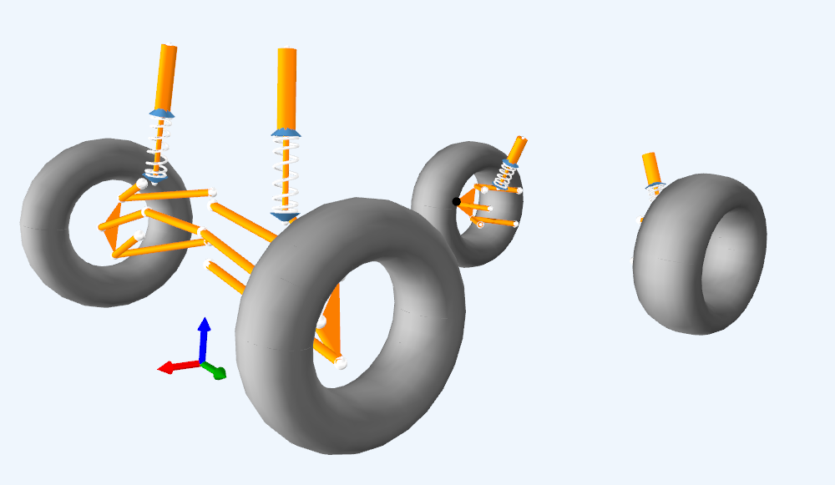
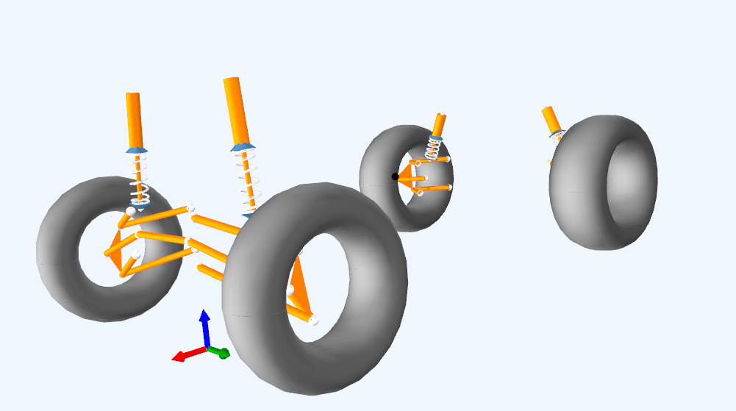
Suspension Geometry Design
Optimum Kinematic Vehicle Models
Version 2
Version 1
Version 3

Slide 18
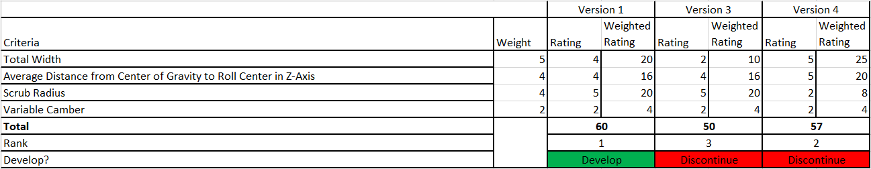
Suspension Geometry Design
Optimum Kinematic Simulation Scoring Matrix
Created a scoring matrix of the simulation values to determine which version we wanted to proceed with as our final design to implement on the knuckle
Selected Version 1 as it had the best overall score
Optimum Kinematic Simulation validated the 2D suspension design and showed how the different criteria change throughout the simulation

Slide 19
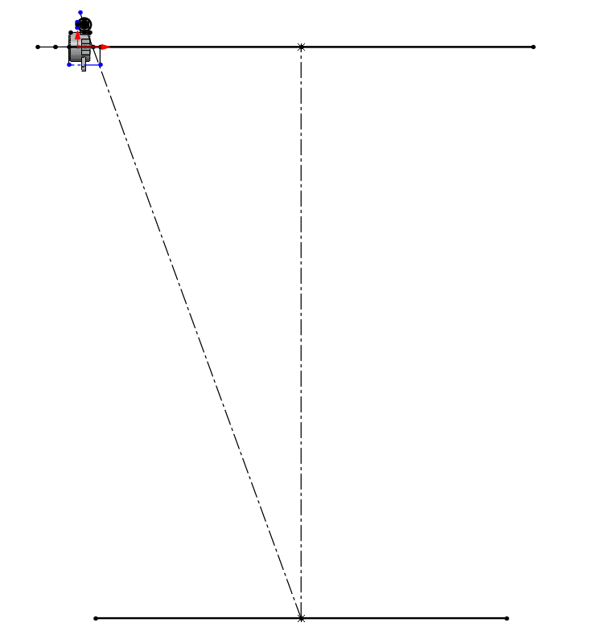
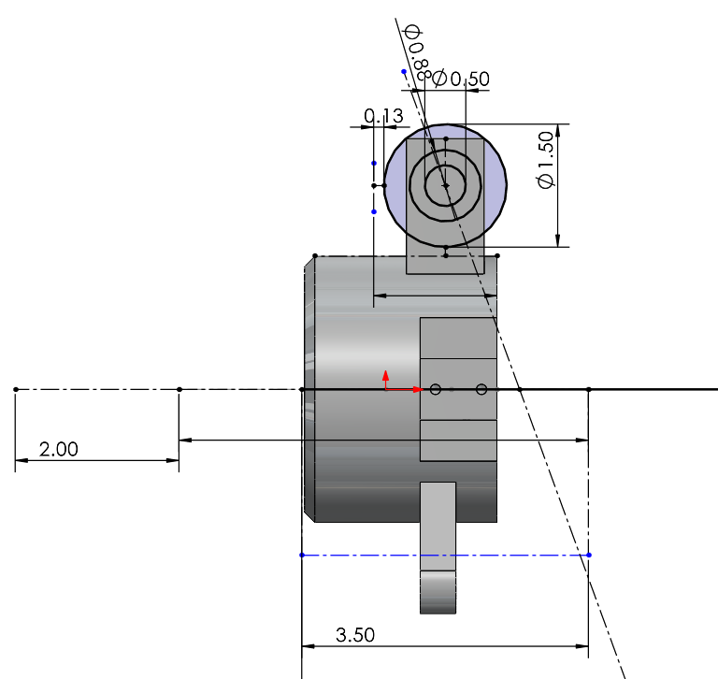
Steering Geometry Design
Ackerman Steering Design

Slide 20
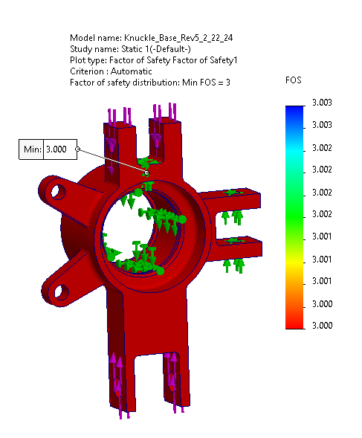
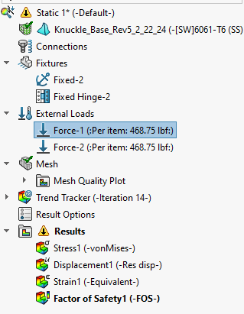
Knuckle FEA

Slide 21
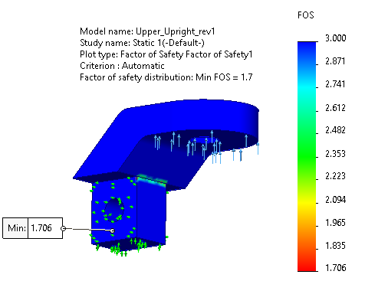
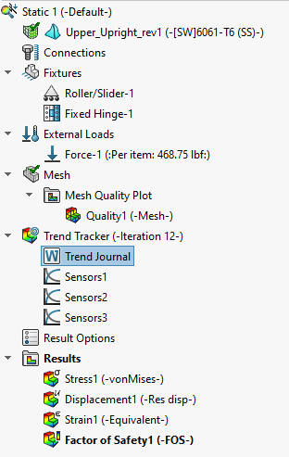
Knuckle FEA

Slide 22
Quality Test
Verified that all dimensions of machined parts are correct before assembling
  A-Arm lengths and bend angles
  Insert dimensions were verified using a test piece of Finishline Tubing
  Knuckle tolerances are correct for press fitting of bearing
    Iterated through CNC programming (3 failed knuckle CNC operations before completing one successful)
First successful iteration was dimensionally verified
  All joints in the knuckle assembly did not collide with the brake rotor
  A-Arms fit into the tabs on the jig and the Cowboy Racing Baja Car
Completed weld tests to ensure that all welds are to Baja SAE Weld Standard
All tolerances were followed while machining per drawings

Slide 23
Testing
Baja Car Testing
Driver Comfort
  Performed on-car testing with new suspension design and handling was significantly improved to previous cars
  Tight turning radius
  Handling during turns
  Minimal bump steer effects
  Design was maintaining strength after jumps (no bending of suspension components after test drives)
  Tested without weld
    Welded for increased factor of safety during competition

Slide 24
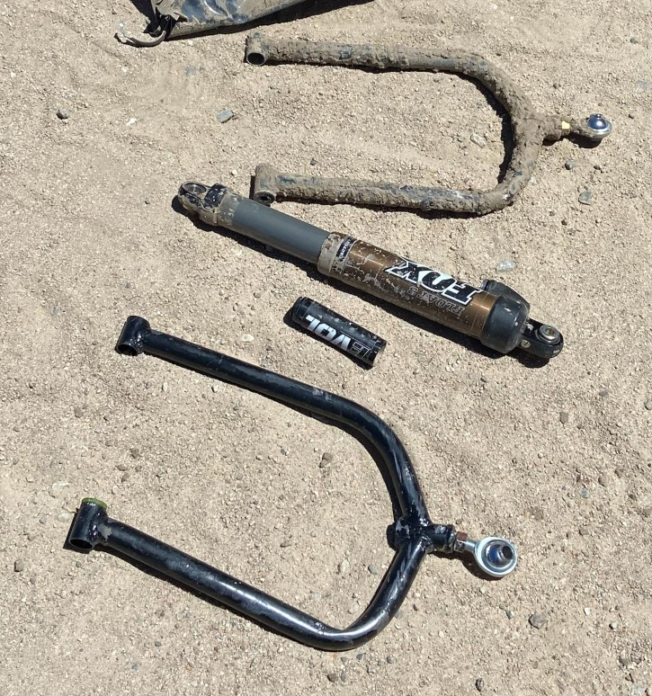
Testing
2024 Baja SAE California
Placed 21st overall out of 61
Placed 18th in maneuverability
Placed 21st in the endurance race
Placed 23rd in hill climb
Placed 31st in acceleration
Placed 32nd in suspension
Suspension components performed better than expected
Only issues were abnormal external forces and driver error
  Lower A-Arm bent via driver hitting rock
  Shock reservoir broke from collision with Baja car

Slide 25
Costs
Total Projected Expenses: $4200
BREAKDOWN
OEM: $1305.98
Manufacturing: $92.24
Joints: $578.30
Fasteners: $276.49
Materials: $1706.19

Slide 26
Any Questions?

Slide 27
SO1: Students demonstrated an ability to identify, formulate, and solve complex engineering problems by applying principles of engineering, science, and mathematics.
Able to identify what suspension characteristics were most important to design for
Completed research on what values for the suspension characteristics were ideal for the Baja vehicle
Created 2D and 3D models and based decision matrices to determine what the best suspension setting was for the Baja car
Completed simulations to validate that our design met all the characteristics and the strength requirement needed for the Baja car

Slide 28
SO2: Students demonstrated an ability to apply the engineering design to produce solutions that meet specified needs with consideration of public health, safety, and welfare, as well as global, cultural, social, environmental, economic factors.
Completed the engineering design process with safety as the main priority ensuring all components had the required strength to endure forces provided by the Baja Car
Ensured that no harmful materials were used in the creation of our design
All manufacturing procedures were performed safely and correctly

Slide 29
SO3: Students demonstrated an ability to communicate effectively with a range of audiences.
Created and presented multiple presentations to advisors, faculty, and students at Oklahoma as well as judges at SAE Baja California explaining our design decisions and integrated advice into our design of the front suspension

Slide 30
SO4: Students demonstrated an ability to recognize ethical and professional responsibilities in engineering situations and make informed judgments, which must consider the impact of engineering solutions in global, economic, environmental, and societal contexts.
Created a safe and robust front suspension design for the 2024 Cowboy Racing Baja Car that prioritized the safety and well-being of the driver
Tested the front suspension and it withstood multiple impacts from the Baja car without breaking
Improved strength of knuckle by welding upright into the knuckle

Slide 31
SO5: Students demonstrated an ability to function effectively on a team whose members together provide leadership, create a collaborative and inclusive environment, establish goals, plan tasks, and meet objectives.
Led team meetings effectively and stayed focused during the design process to meet all deadlines
Held a strict manufacturing process as a team and did not make the deadline due to machining errors
Created a detailed schedule for design, fabrication, and testing

Slide 32
SO6: Students demonstrated an ability to develop and conduct appropriate experimentation, analyze and interpret data, and use engineering judgment to draw conclusions.
Created multiple screening and scoring matrices from suspension settings testing and simulations to determine which suspension geometry design would best suit the Cowboy Racing Team
Completed suspension design simulations and finite element analysis on suspension components to ensure strength and that the design would work on the Cowboy Racing car

Slide 33
SO7: Students demonstrated an ability to acquire and apply new knowledge as needed, using appropriate learning strategies.
Read and acquire information from textbooks, YouTube videos, and faculty advice to determine what suspension geometry setting would best suit the Cowboy Racing Baja Car
Textbooks include: Fundamentals of Vehicle Design, Race Car Vehicle Design, Shigley's Mechanical Design Textbook, Chassis Design: Principles and Analysis
Completed Benchmarking of other successful Baja Teams (Michigan, RIT, ETS) to make our design competition ready
Watched tutorial videos to successfully perform Finite Element Analysis and suspension simulations using Optimum Kinematics

